Slide 1
Topic06.Data Visualization
資料科學 Data Science
張家銘 Jia-Ming Chang
政治大學資訊科學系
The slide isonly for educational purposes. If any infringement, please contact me and we will correct immediately.

Slide 2
Copyright declaration 版權說明
Some of the figures in this presentation are taken from "An Introduction to Statistical Learning, with applications in R" (Springer, 2013) with permission from the authors: G. James, D. Witten, T. Hastie and R. Tibshirani.
The web site of the book
The credit of individual is indicated in the bottom part of the slide.
ie.,

Slide 3
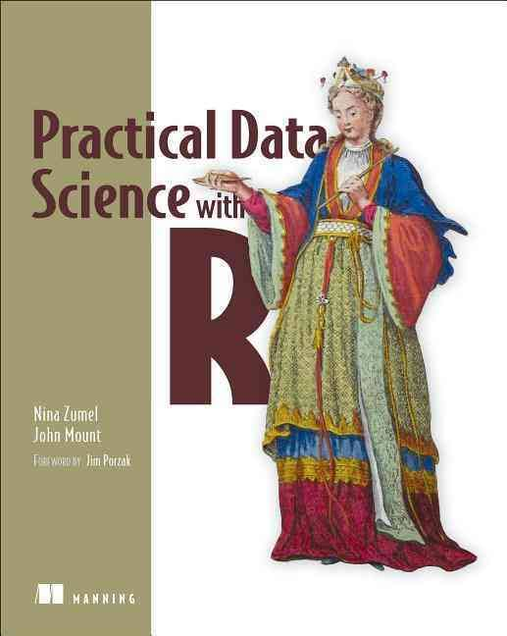
Copyright declaration 版權說明
Some of the figures in this presentation are taken from "Practical Data Science with R (Manning, 2019)”
The web site of the book
The credit of individual is indicated in the bottom part of the slide.
ie.,

Slide 4
Copyright declaration 版權說明
Some of the figures in this presentation are taken from "R for Data Science” under the Creative Commons Attribution-NonCommercial-NoDerivs 3.0 License.
The web site of the book
The credit of individual is indicated in the bottom part.
ie.,

Slide 5
Data Science this week
Elon Musk’s OpenAI Unveils a Simpler Way for Machines to Learn
The group says it has a more practical way to get software to learn tasks, such as steering robots, that require multiple actions.
by Tom Simonite March 27, 2017
https://goo.gl/LhEX3X
https://openai.com/

Slide 6
Recap for the last week

Slide 7
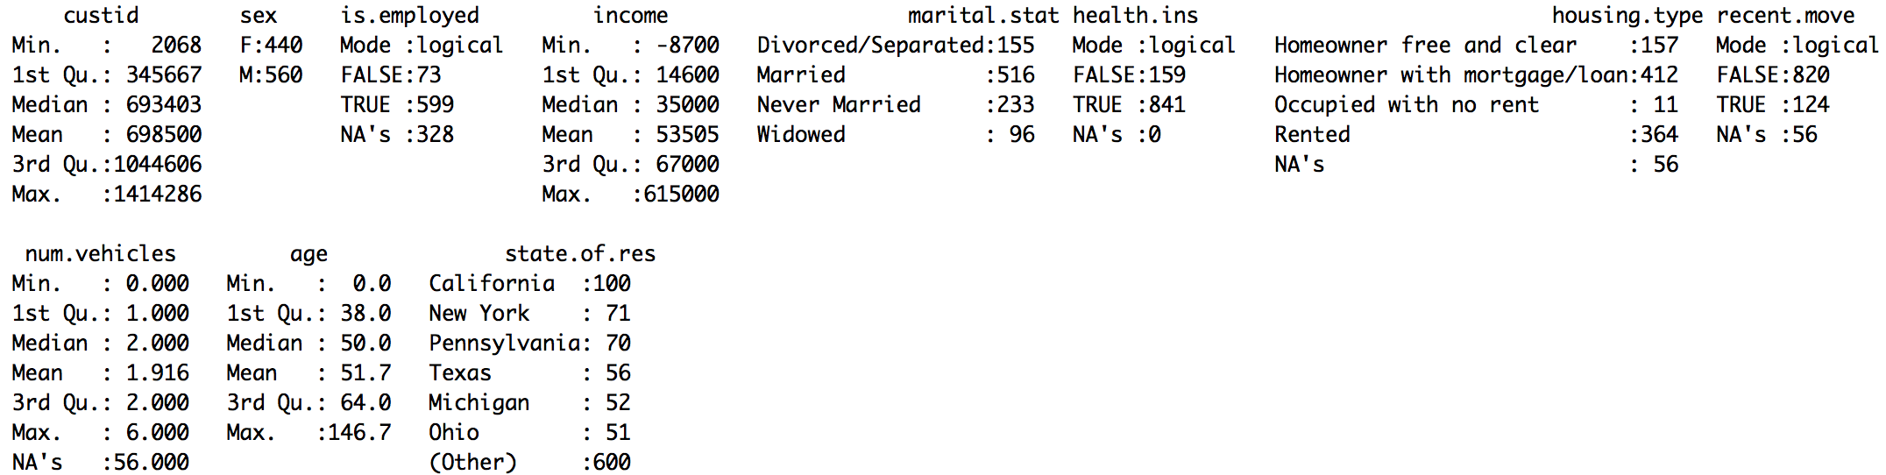
Typical problems revealed by data summaries
Missing values
Invalid values and outliers
Data range
Units
Practical Data Science with R by Nina Zumel, John Mount​

Slide 8
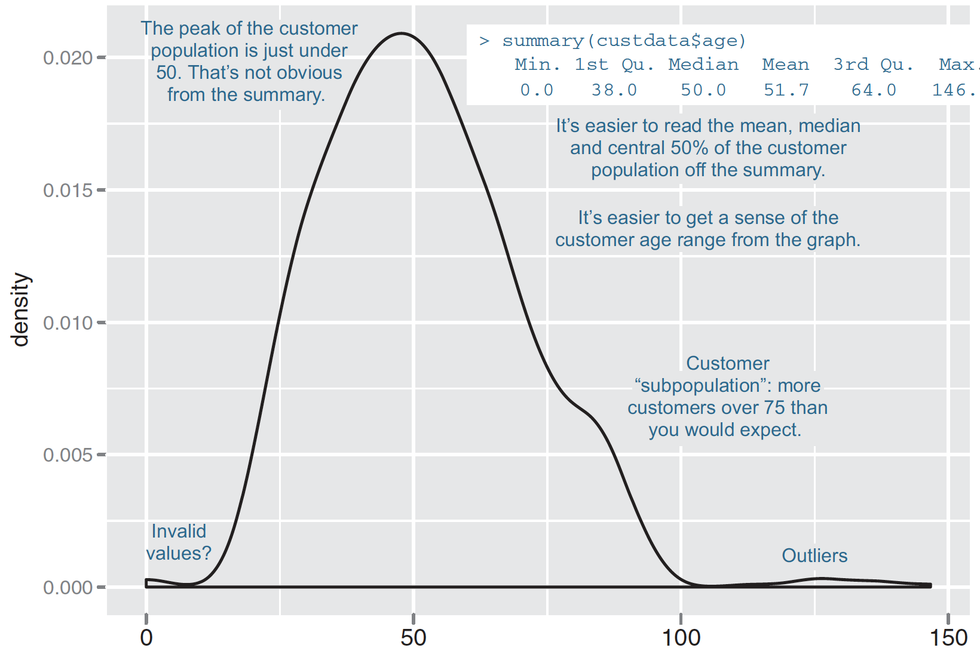
Some information is easier to read from a graph, and some from a summary.
Figure 3.1, Practical Data Science with R by Nina Zumel, John Mount

Slide 9
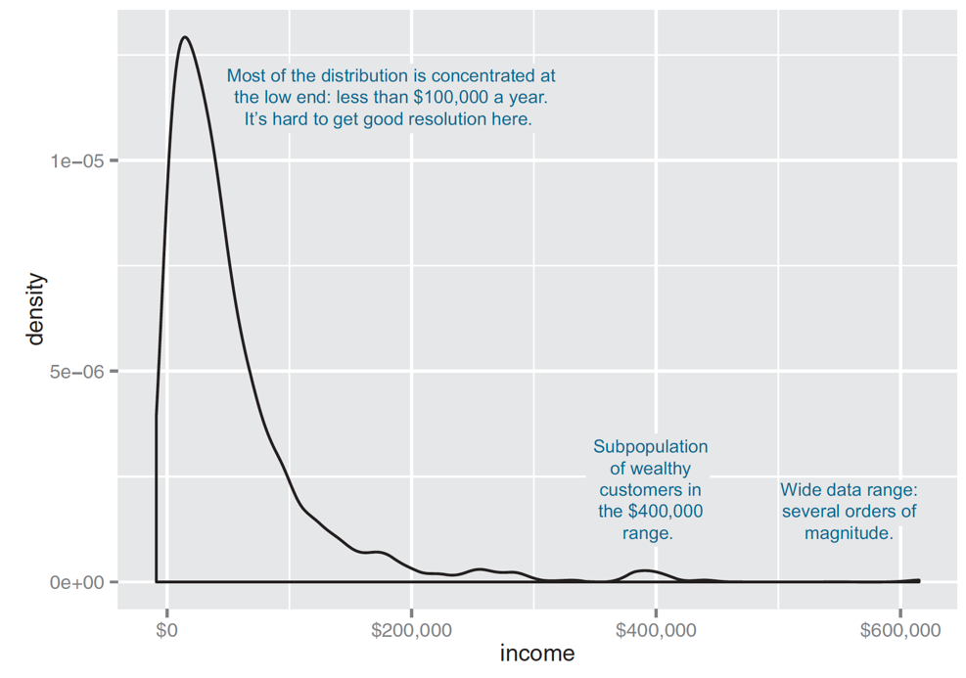
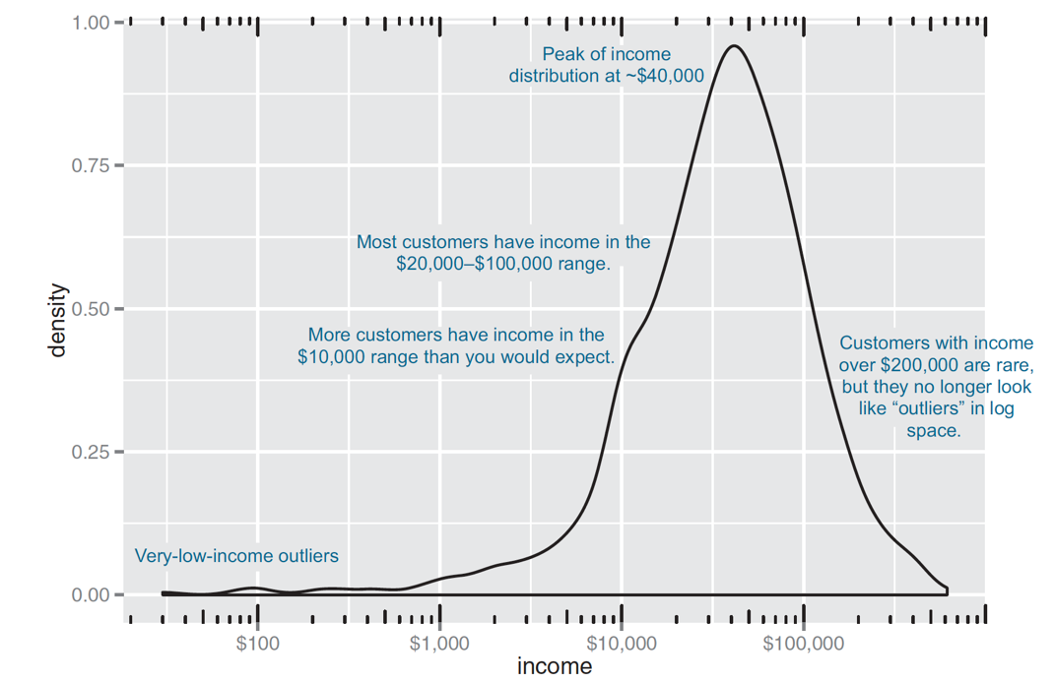
DENSITY PLOTS
When the data range
very wide
the mass of the distribution is heavily concentrated to one side (difficult to see the details of its shape)
non-negative
library(scales)
ggplot(custdata) + geom_density(aes(x=income)) +
scale_x_continuous(labels=dollar)
ggplot(custdata) + geom_density(aes(x=income)) +
scale_x_log10(breaks=c(100,1000,10000,100000), labels=dollar) + annotation_logticks(sides="bt")
Figure3.4 & 3.5, Practical Data Science with R by Nina Zumel, John Mount​

Slide 10
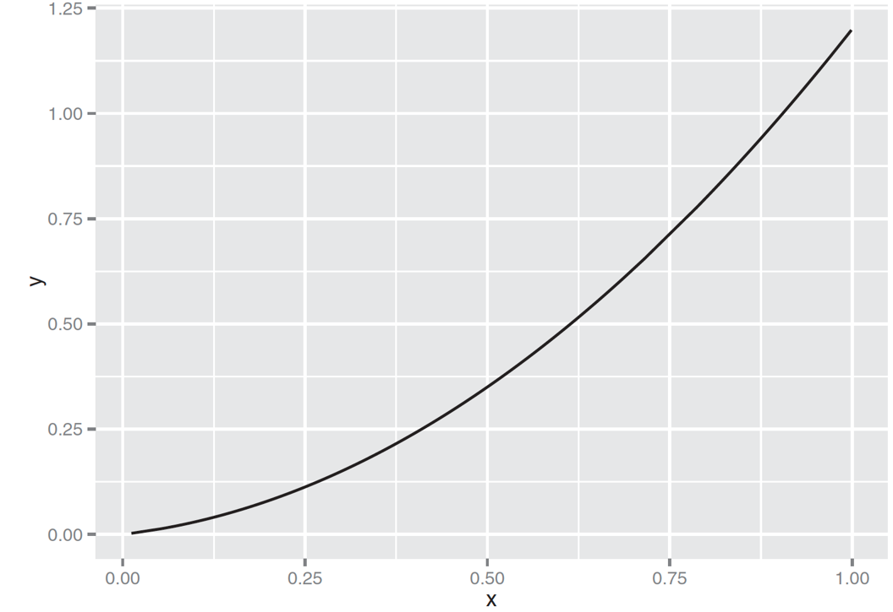
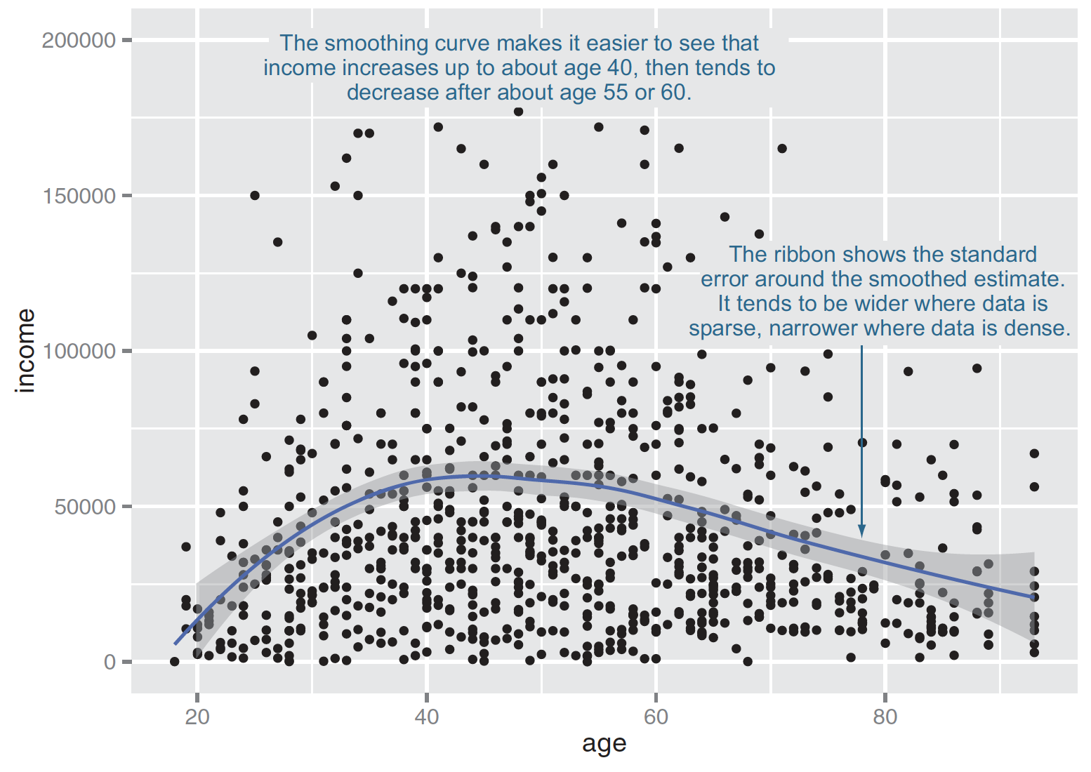
Line points vs. smoothing curve
relation.R
x <- runif(100)
y <- x^2 + 0.2*x
ggplot(data.frame(x=x,y=y), aes(x=x,y=y)) + geom_line()
ggplot(custdata2, aes(x=age, y=income)) + geom_point() + geom_smooth() + ylim(0, 200000)
Figure3.9 & 3.12, Practical Data Science with R by Nina Zumel, John Mount​

Slide 11
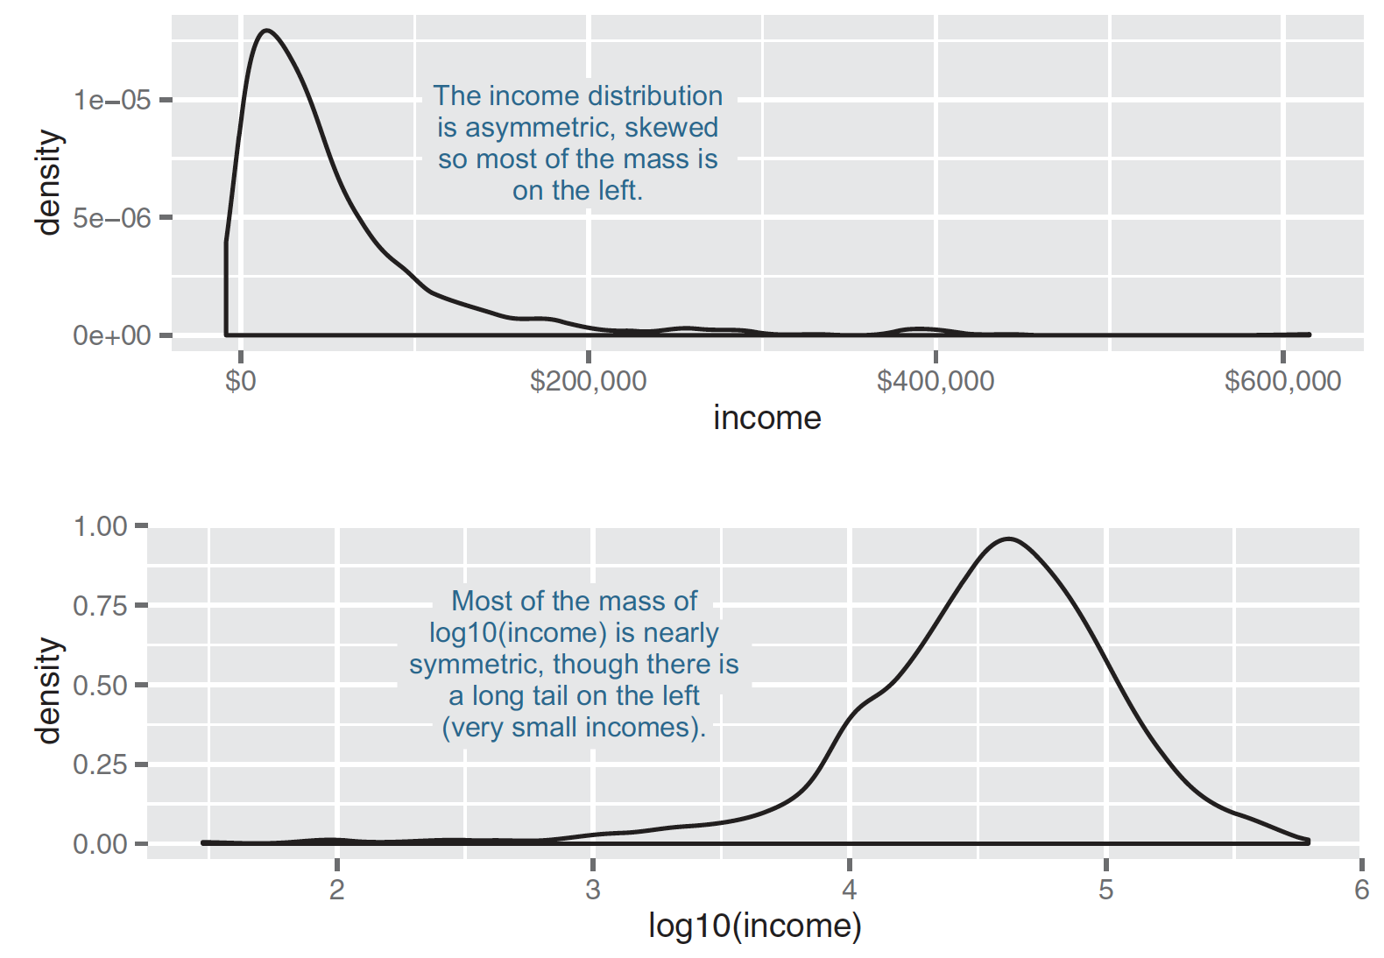
A nearly lognormal distribution and its log
Figure 4.4, Practical Data Science with R by Nina Zumel, John Mount

Slide 12
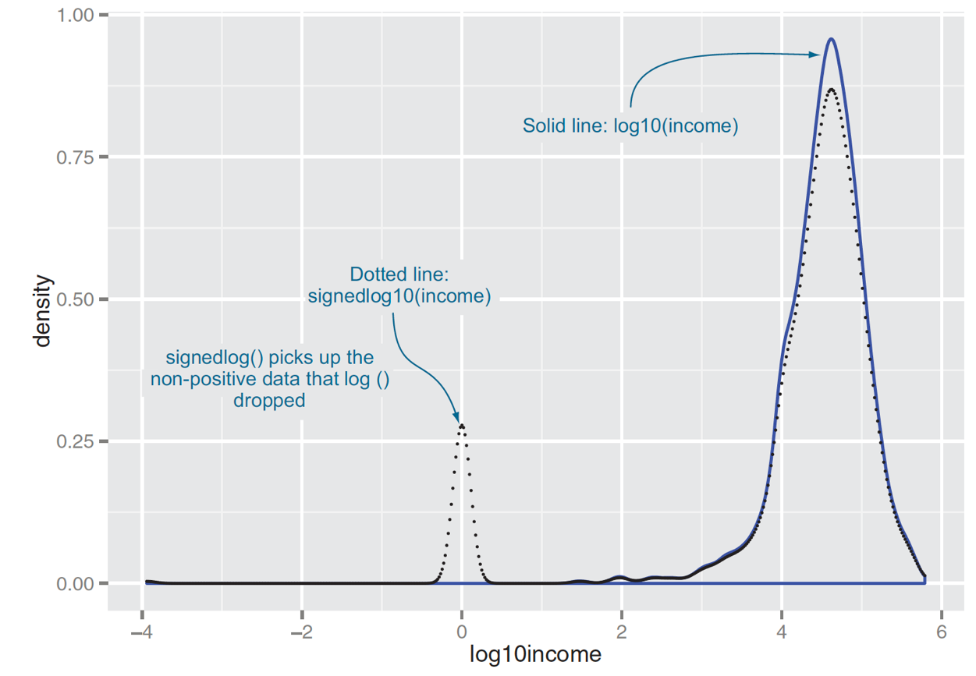
If the data is negative?
signedlog10 <- function(x) {
ifelse(abs(x) <= 1, 0, sign(x)*log10(abs(x)))
}
Figure4.5, Practical Data Science with R by Nina Zumel, John Mount

Slide 13
Sampling for modeling and validation
train/calibration, test
Splitting into test and training using a random group mark
custdata$gp <- runif(dim(custdata)[1])
testSet <- subset(custdata, custdata$gp <= 0.1)
trainingSet <- subset(custdata, custdata$gp > 0.1)
Practical Data Science with R by Nina Zumel, John Mount

Slide 14
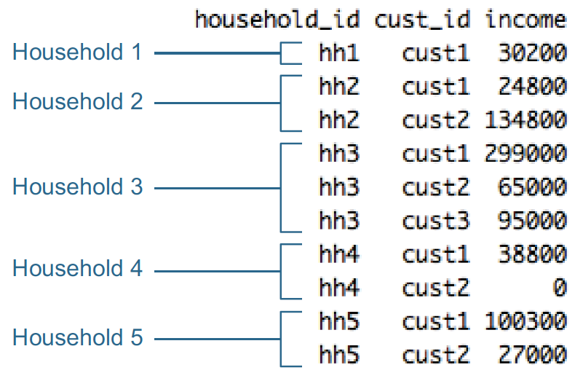
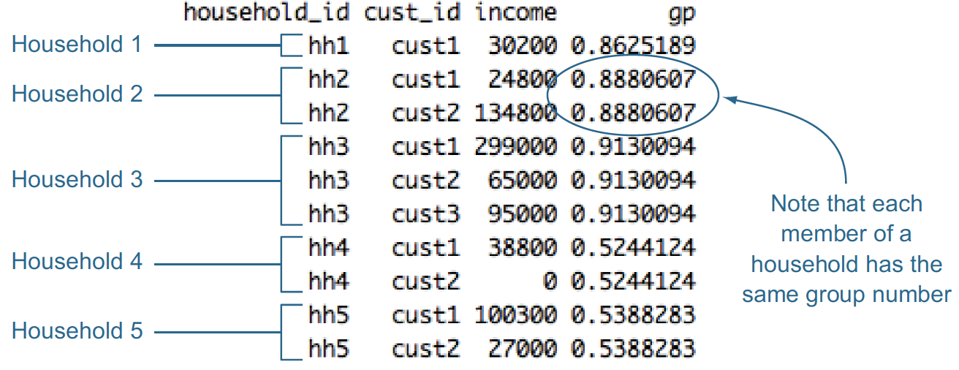
Record grouping
hh <- unique(hhdata$household_id)
households <- data.frame(household_id = hh, gp = runif(length(hh)))
hhdata <- merge(hhdata, households, by="household_id")
Figure4.7, Practical Data Science with R by Nina Zumel, John Mount

Slide 15
Summary
What you do with missing values depends on how many there are, and whether they’re missing randomly or systematically.
When in doubt, assume that missing values are missing systematically.
Appropriate data transformations can make the data easier to understand and easier to model.
Normalization and rescaling are important when relative changes are more important than absolute ones.
Data provenance records help reduce errors as you iterate over data collection, data treatment, and modeling.
Practical Data Science with R by Nina Zumel, John Mount

Slide 16
Data visualization

Slide 17
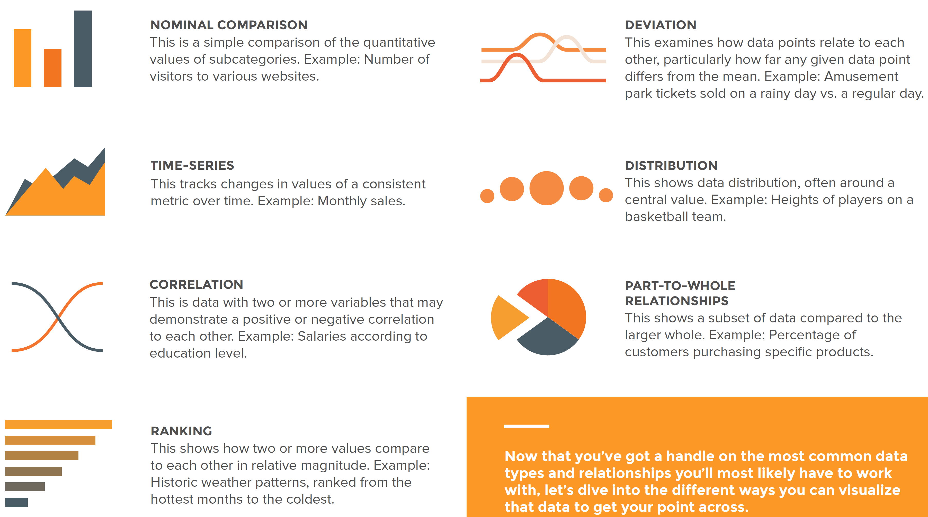
Data Relationships
Credit by Data Visualization 101: How To Design Charts and Graphs, by HubSpot and Visage

Slide 18
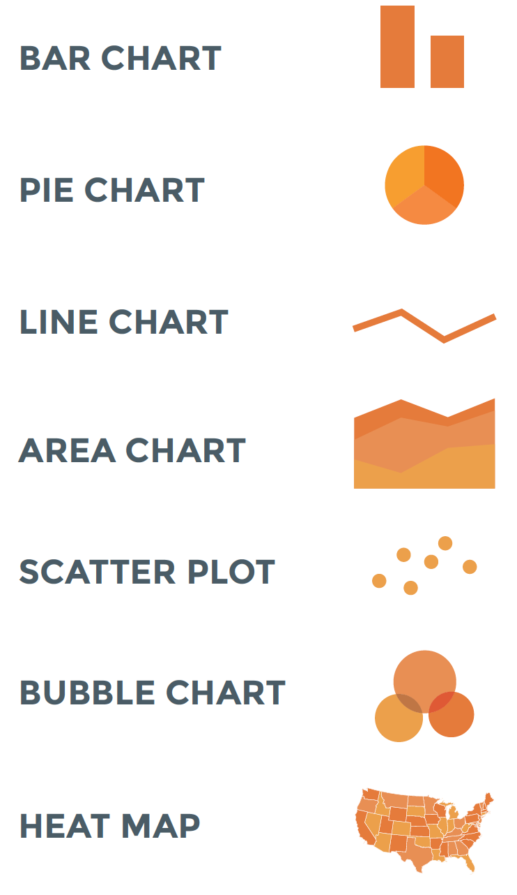
Guide to chart types
Credit by https://visage.co/data-visualization-101-pie-charts/

Slide 19
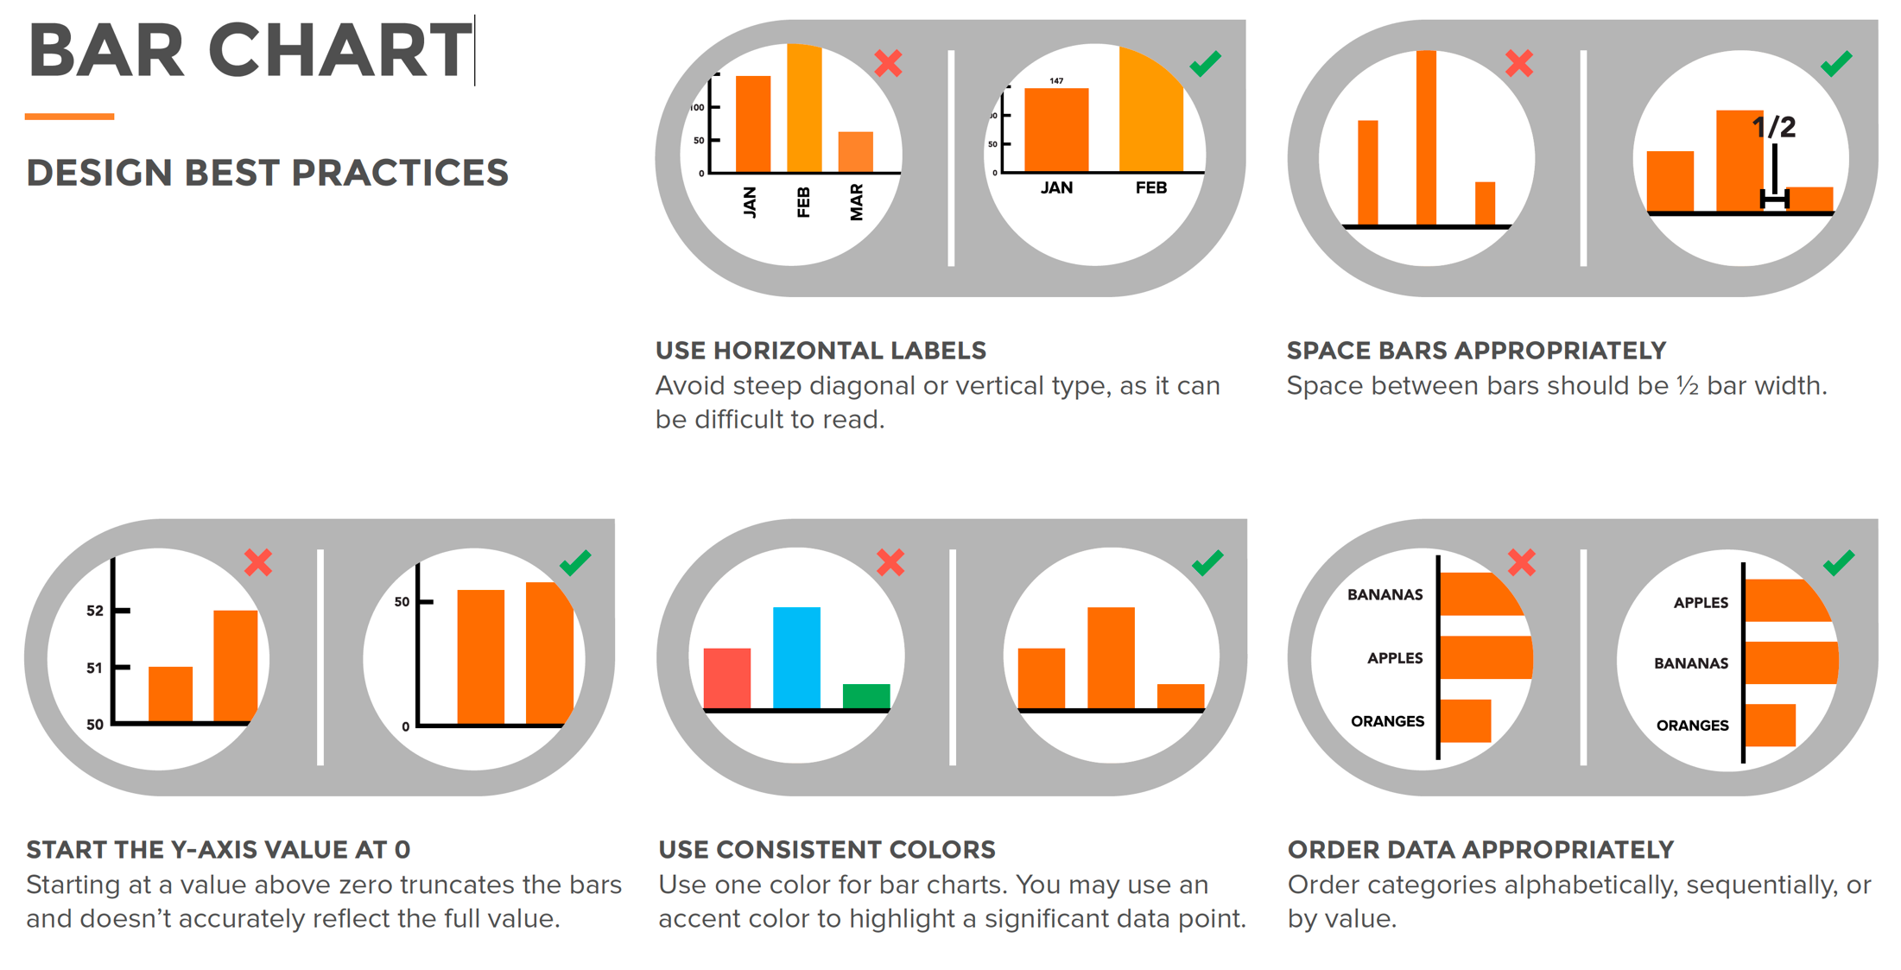
Credit by https://visage.co/data-visualization-101-pie-charts/

Slide 20
Pie Chart
piechart.R
slices <- c(10, 12, 4, 16, 8)
lbls <- c("US", "UK", "Australia", "Germany", "France") pct <- round(slices/sum(slices)*100) lbls <- paste(lbls, pct) # add percents to labels
lbls <- paste(lbls,"%",sep="") # ad % to labels
pie(slices,labels = lbls, main="Pie Chart of Countries")

Slide 21
Data visualization
Grading1
Homework 60%
Midterm 15%
Final Project 25%
Grading2
Homework 70%
Midterm 10%
Final project 20%

Slide 22
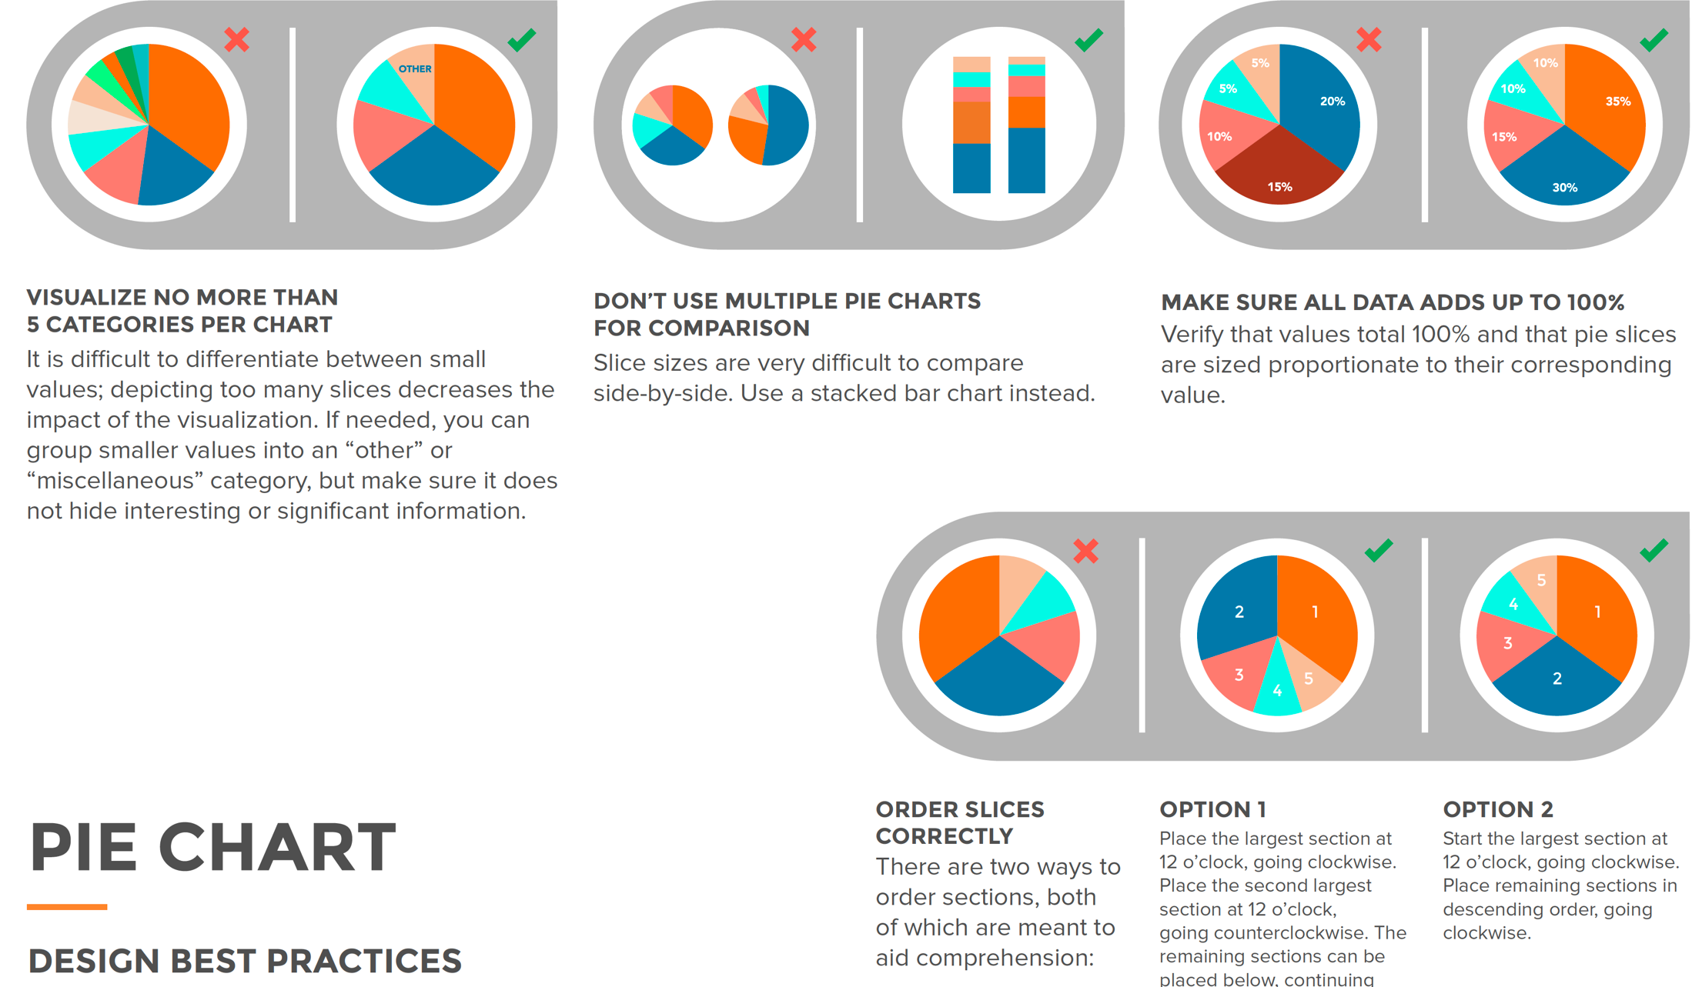
Credit by Data Visualization 101: How To Design Charts and Graphs, by HubSpot and Visage

Slide 23
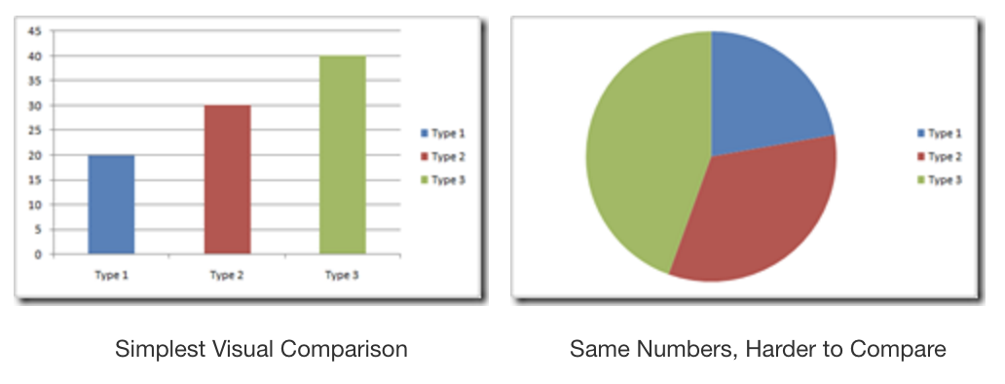
Pie Chart vs Bar Chart
Visualize no more than 5 categories per chart.
Credit by http://www.powerpivotpro.com/2009/12/the-death-of-pie-charts/

Slide 24
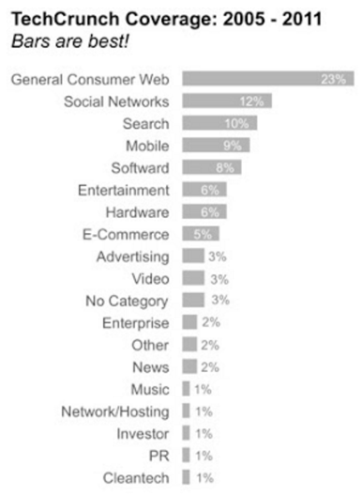
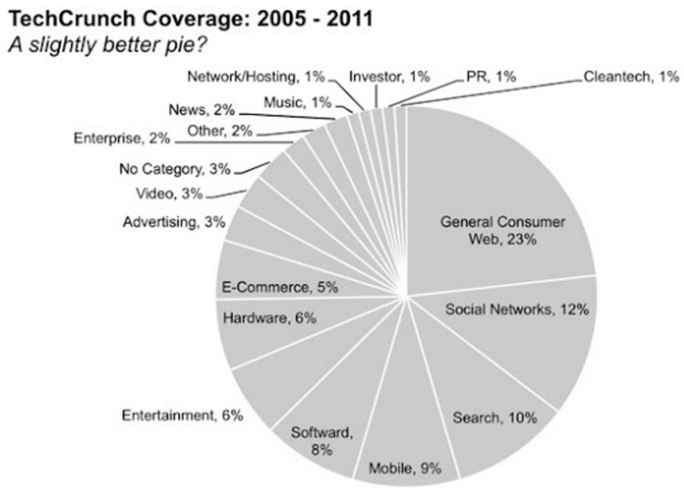
Pie Chart vs Bar Chart
Visualize no more than 5 categories per chart.
http://www.storytellingwithdata.com/blog/2011/07/death-to-pie-charts

Slide 25
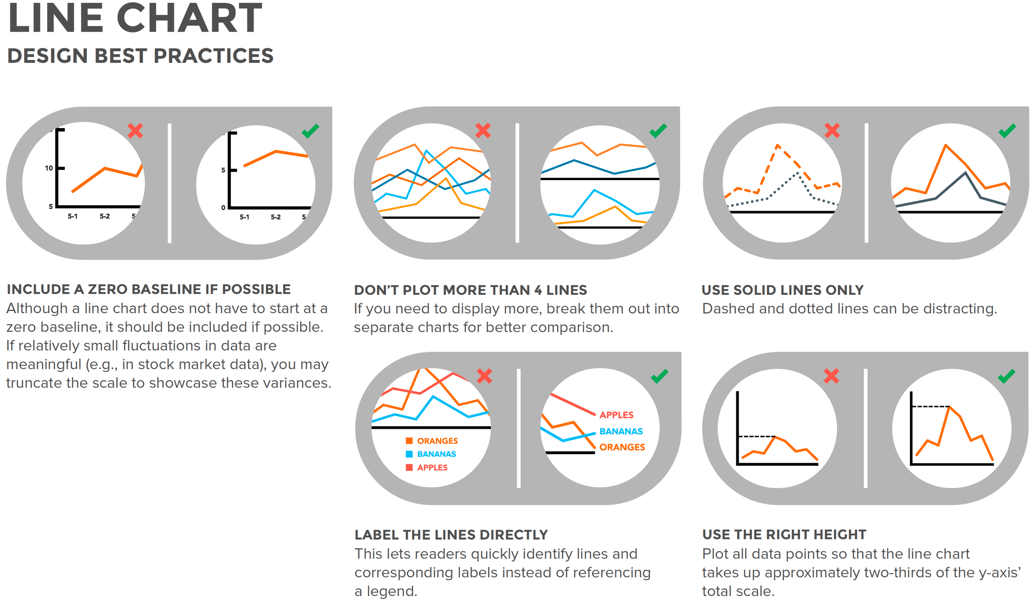

Credit by Data Visualization 101: How To Design Charts and Graphs, by HubSpot and Visage

Slide 26
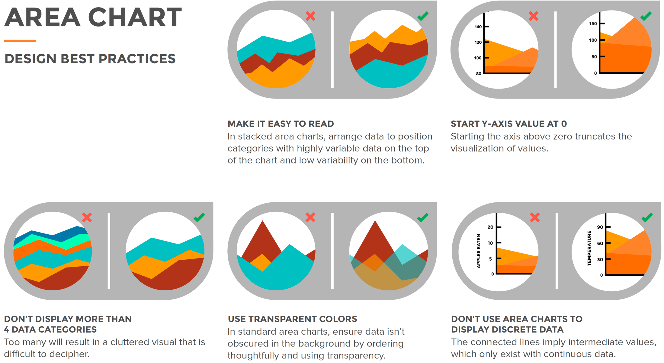
Credit by Data Visualization 101: How To Design Charts and Graphs, by HubSpot and Visage

Slide 27
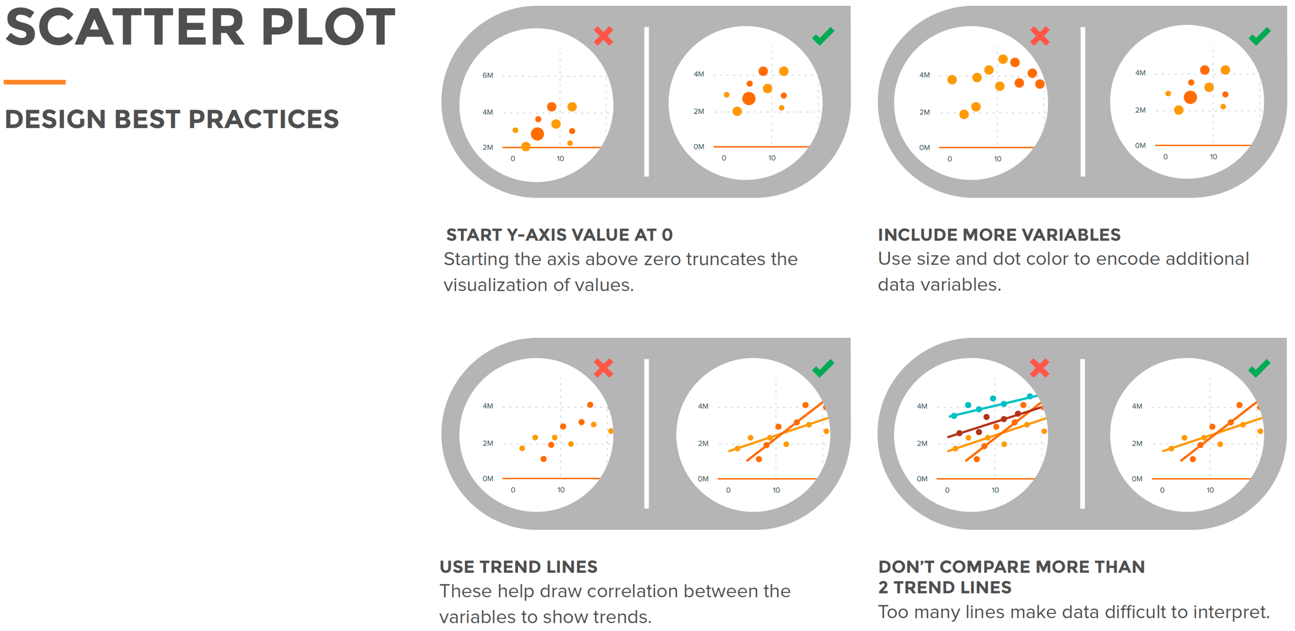
Credit by Data Visualization 101: How To Design Charts and Graphs, by HubSpot and Visage

Slide 28
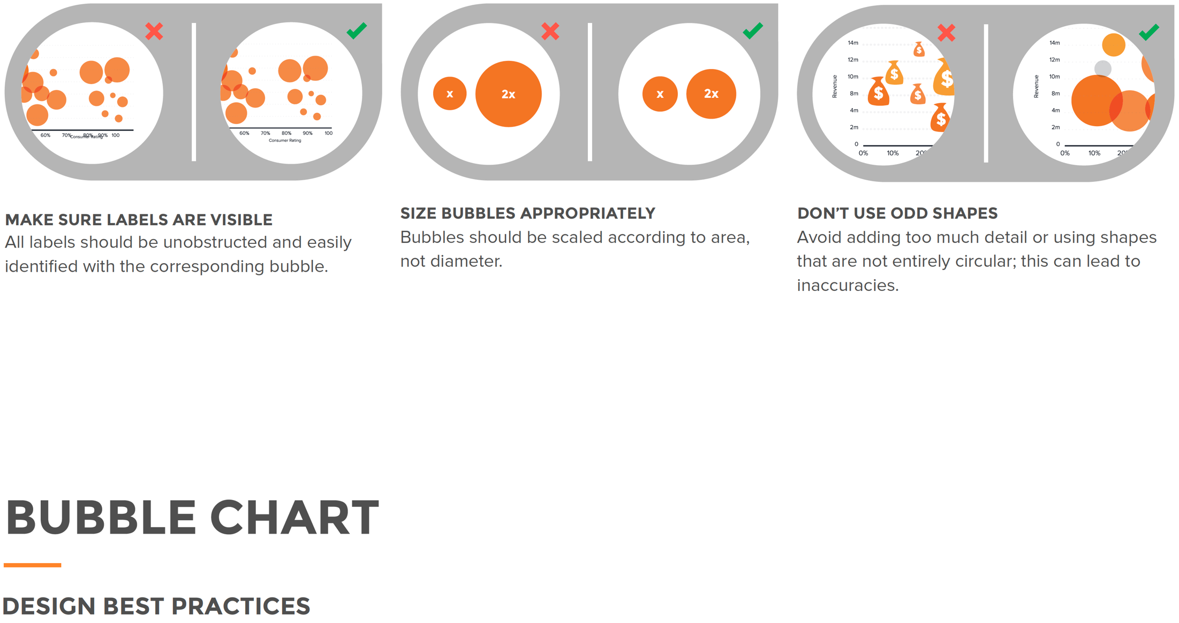
Credit by Data Visualization 101: How To Design Charts and Graphs, by HubSpot and Visage

Slide 29
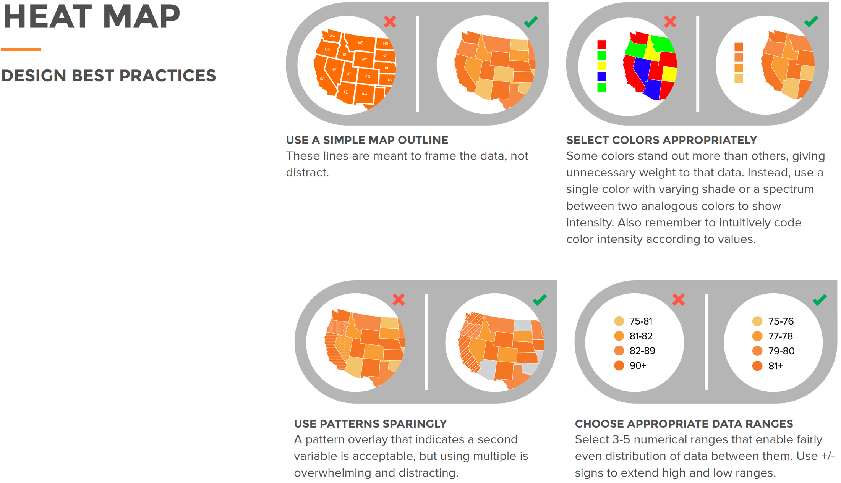
Credit by Data Visualization 101: How To Design Charts and Graphs, by HubSpot and Visage

Slide 30
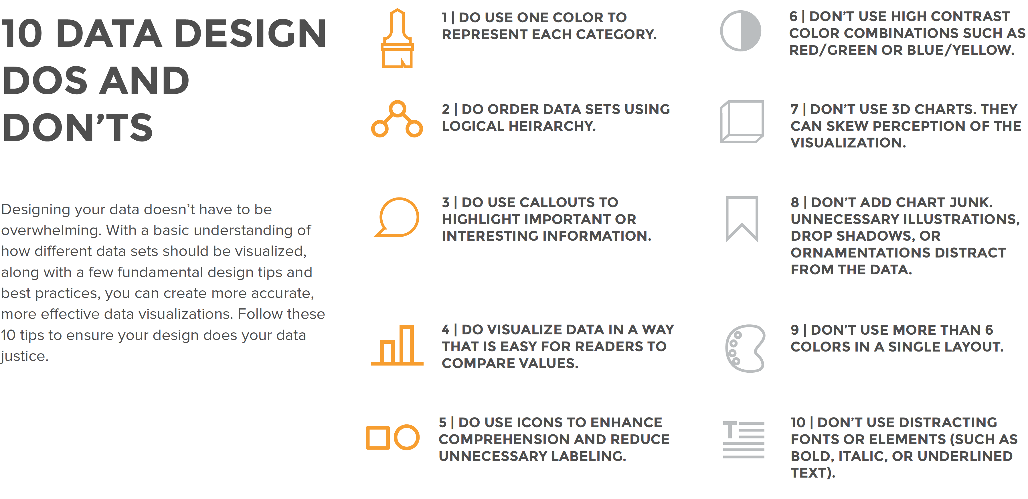
Credit by Data Visualization 101: How To Design Charts and Graphs, by HubSpot and Visage

Slide 31
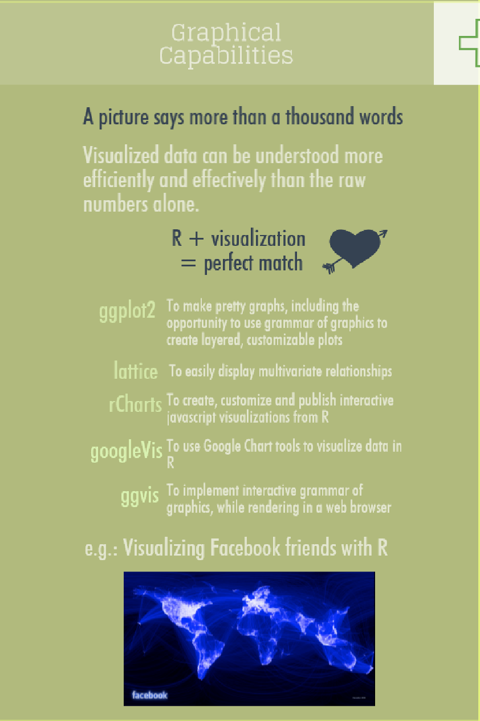
Credit by https://www.datacamp.com/community/tutorials/r-or-python-for-data-analysis

Slide 32
ggplot2

Slide 33
ggplot2
http://ggplot2.org/
one of the best static visualization packages in R
a plotting system for R, based on the grammar of graphics, which tries to take the good parts of base and lattice graphics and none of the bad parts. It takes care of many of the fiddly details that make plotting a hassle (like drawing legends) as well as providing a powerful model of graphics that makes it easy to produce complex multi-layered graphics.

Slide 34
ggplot2 call
ggplot.R
Which one will you use?
ggplot(data = faithful, mapping = aes(x = eruptions)) + geom_freqpoly(binwidth = 0.25)
ggplot(faithful, aes(eruptions)) + geom_freqpoly(binwidth = 0.25)
R for Data Science by Garrett Grolemund, Hadley Wickham

Slide 35
Box Plot

Slide 36
Boxplot
R for Data Science by Garrett Grolemund, Hadley Wickham

Slide 37
Notch

Slide 38
boxplot
boxplot.R
ggplot(data = mpg, mapping = aes(x = class, y = hwy)) + geom_boxplot()
What is problem?
ggplot(data = mpg) + geom_boxplot(mapping = aes(x = reorder(class, hwy, FUN = median), y = hwy))
What is problem?
ggplot(data = mpg) + geom_boxplot(mapping = aes(x = reorder(class, hwy, FUN = median), y = hwy)) + coord_flip()
R for Data Science by Garrett Grolemund, Hadley Wickham

Slide 39
Two variables?

Slide 40
Visually checking relationships between two variables
Is there a relationship
between the two inputs age and income in my data?
between the input marital status and the output health
What kind of relationship, and how strong?
Practical Data Science with R by Nina Zumel, John Mount

Slide 41
Scatter Plots
Two numerical variables

Slide 42
Two continuous variables
Relation between carat & price
ggplot(data = diamonds) + geom_point(mapping = aes(x = carat, y = price))
What is problem?
ggplot(data = diamonds) + geom_point(mapping = aes(x = carat, y = price), alpha = 1 / 100)
What is problem?
ggplot(data = smaller) + geom_bin2d(mapping = aes(x = carat, y = price))
R for Data Science by Garrett Grolemund, Hadley Wickham

Slide 43
Two continuous variables
bin one continuous variable into a categorical variable
ggplot(data = smaller, mapping = aes(x = carat, y = price)) + geom_boxplot(mapping = aes(group = cut_width(carat, 0.1)))
R for Data Science by Garrett Grolemund, Hadley Wickham

Slide 44

Line Plots
relation.R
x <- runif(100)
y <- x^2 + 0.2*x
ggplot(data.frame(x=x,y=y), aes(x=x,y=y)) + geom_line()
Figure3.9, Practical Data Science with R by Nina Zumel, John Mount

Slide 45
Line Plot does not work
When the data is not so cleanly related, line plots aren’t as useful!
custdata2 <- subset(custdata, (custdata$age > 0 & custdata$age < 100 & custdata$income > 0))
ggplot(custdata2, aes(x=custdata2$age, y=custdata2$income)) + geom_line()
Practical Data Science with R by Nina Zumel, John Mount

Slide 46
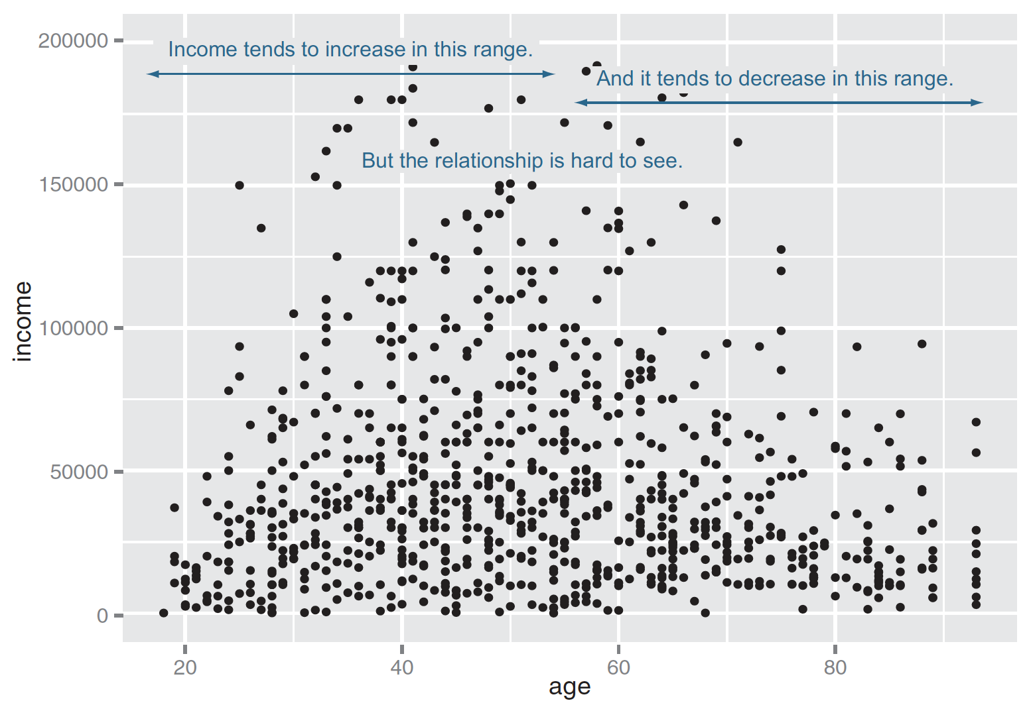
Scatter Plots
ggplot(custdata2, aes(x=age, y=income)) + geom_point() + ylim(0, 200000)
Figure3.10, Practical Data Science with R by Nina Zumel, John Mount

Slide 47
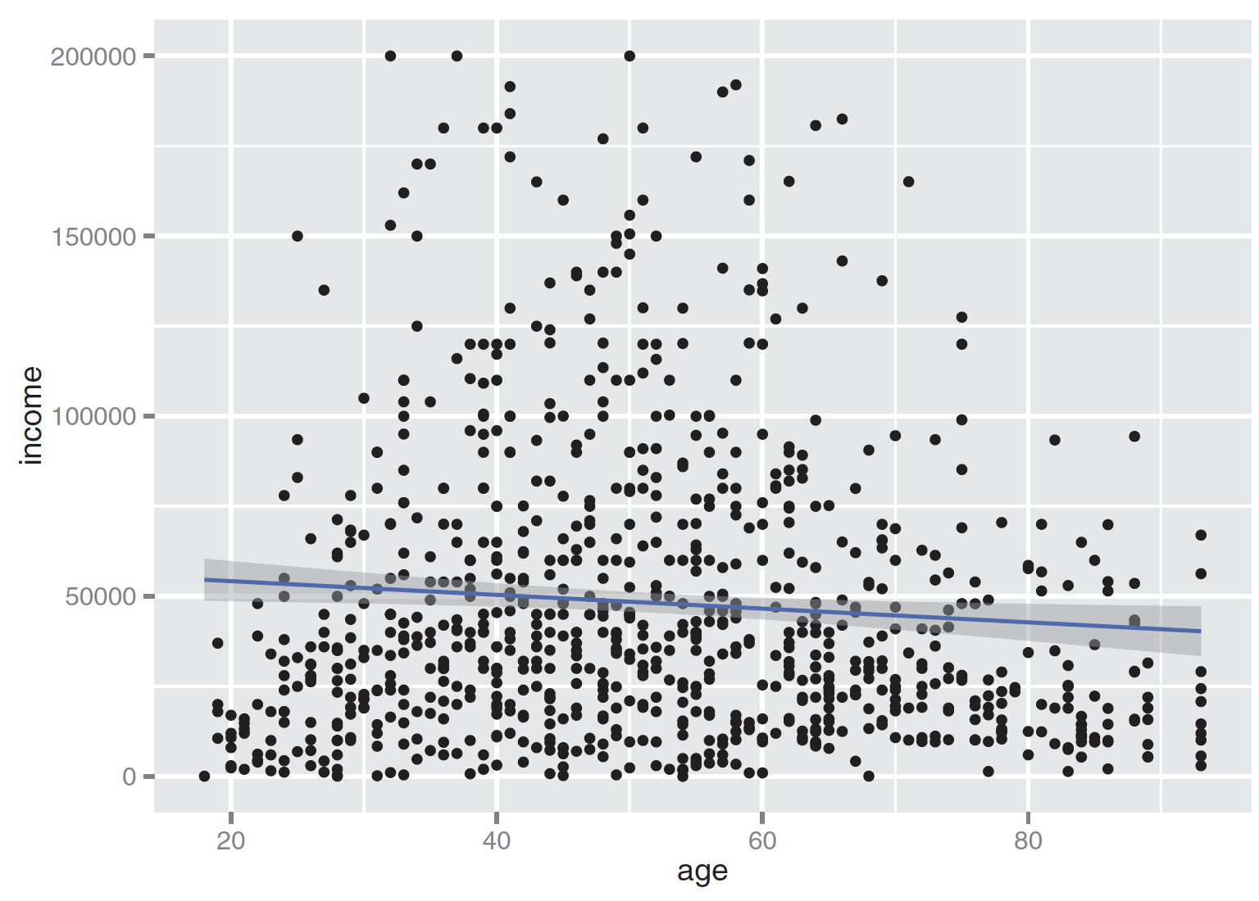
Linear fit
ggplot(custdata2, aes(x=age, y=income)) + geom_point() + stat_smooth(method="lm") + ylim(0, 200000)
cor(custdata2$age, custdata2$income)
Figure3.11, Practical Data Science with R by Nina Zumel, John Mount

Slide 48
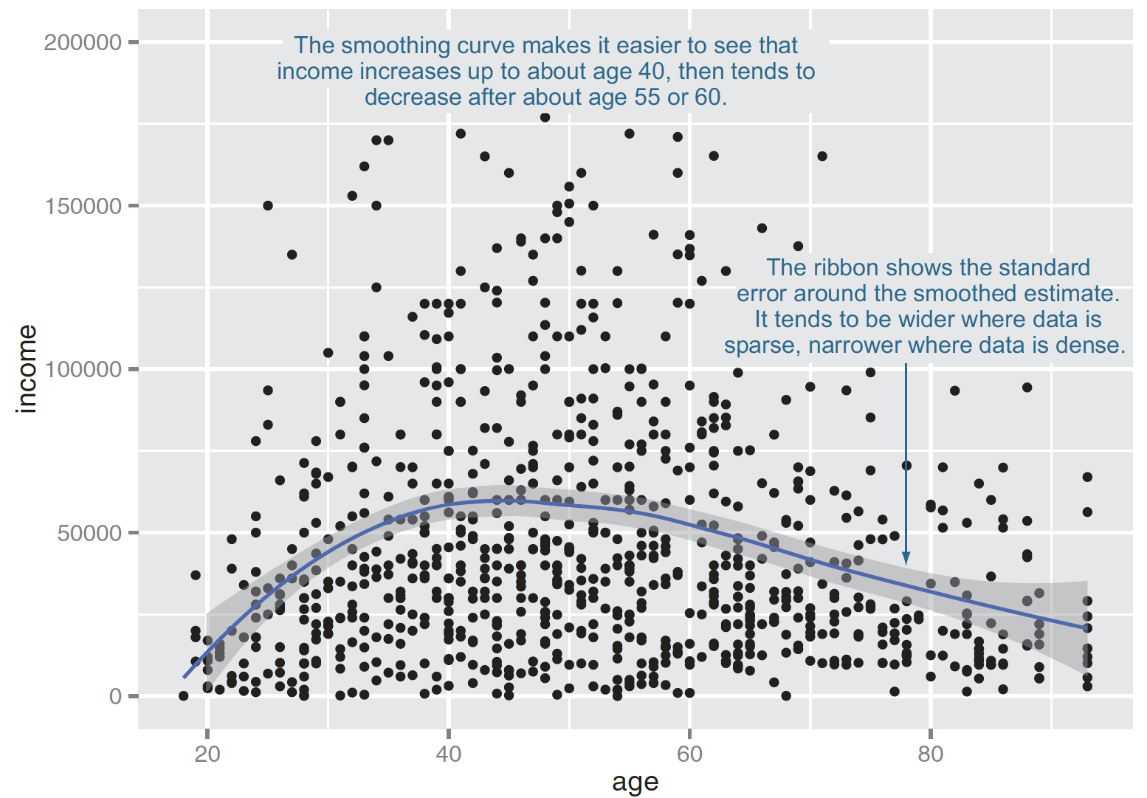
Smoothing curve
fit using the loess (or lowess ) functions, which calculate smoothed local linear fits of the data.
ggplot(custdata2, aes(x=age, y=income)) + geom_point() + geom_smooth() + ylim(0, 200000)
Figure3.11, Practical Data Science with R by Nina Zumel, John Mount

Slide 49
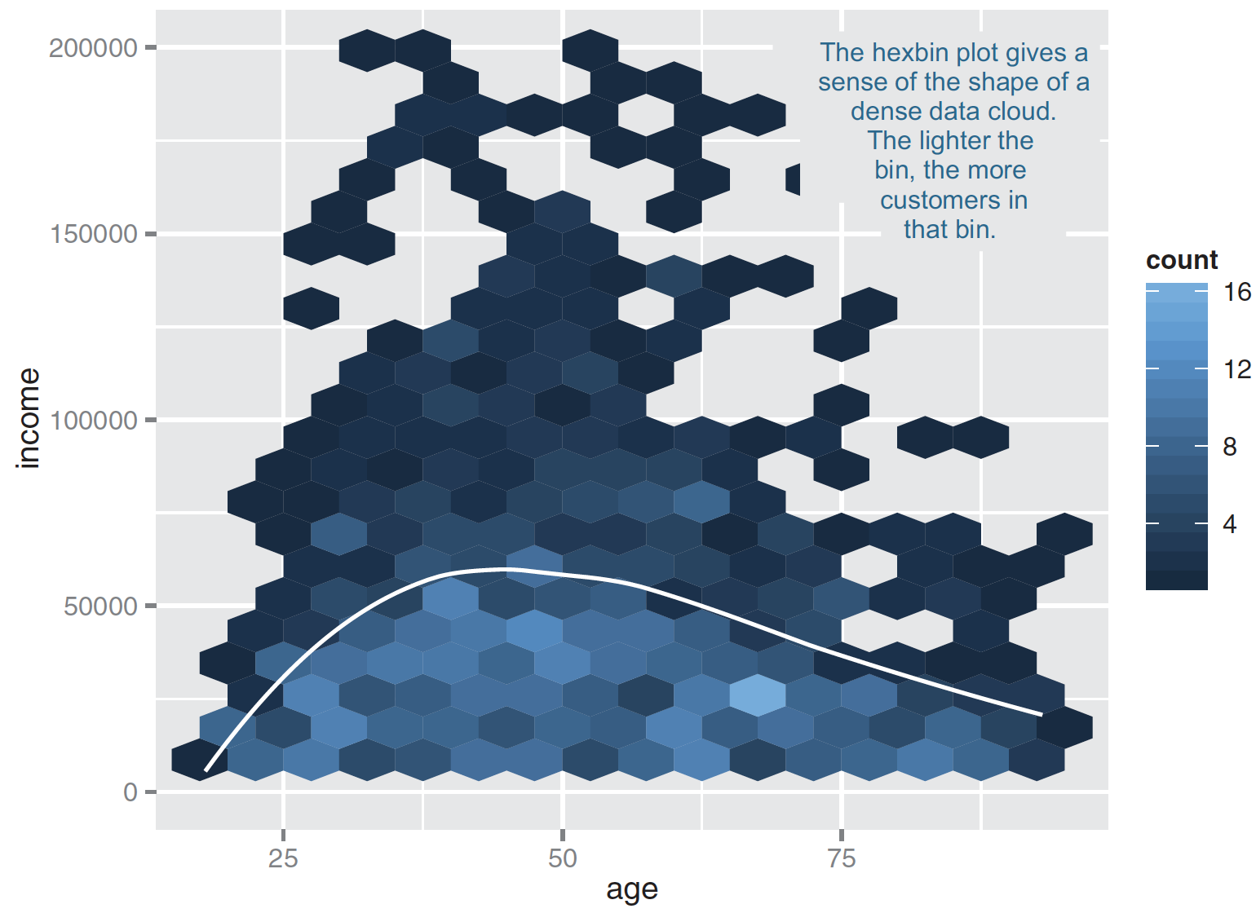
High-volume situations => HEXBIN PLOTS
library(hexbin)
ggplot(custdata2, aes(x=age, y=income)) +
geom_hex(binwidth=c(5, 10000)) +
geom_smooth(color="white", se=F) + ylim(0,200000)
Figure3.14, Practical Data Science with R by Nina Zumel, John Mount

Slide 50
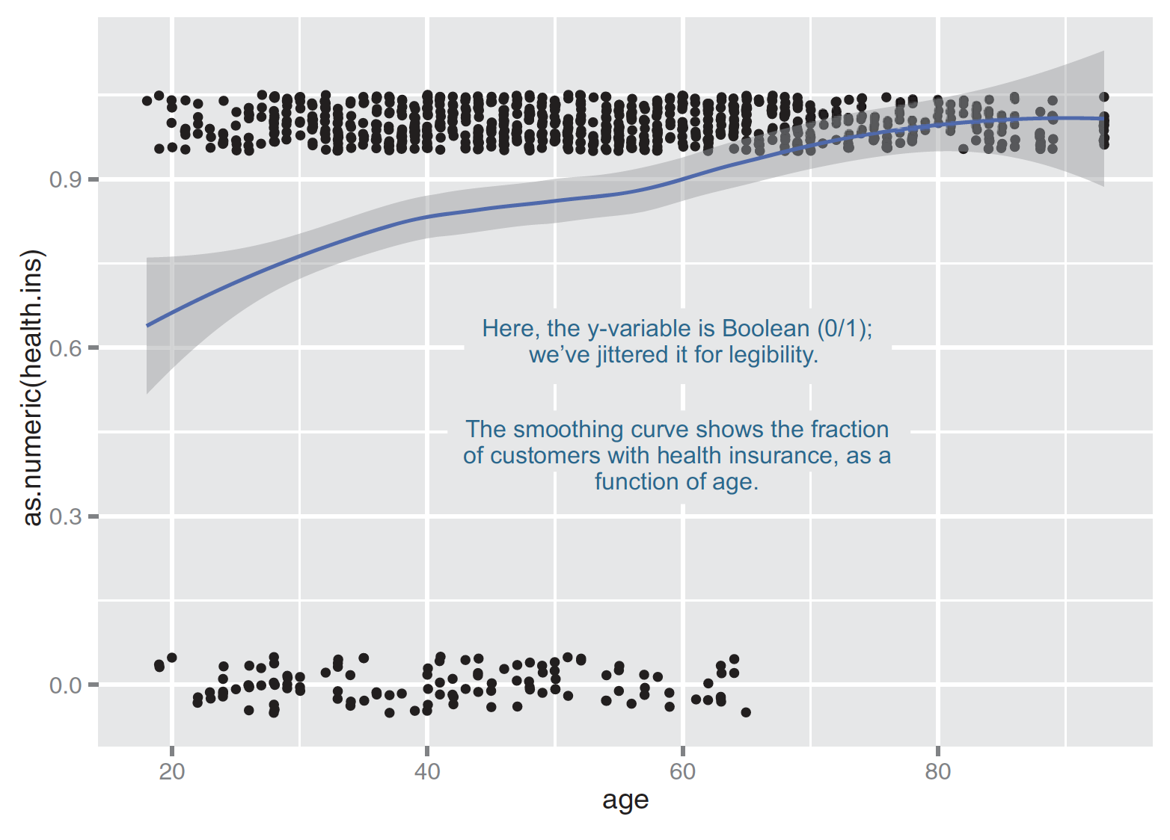
Smoothing curve for boolean variables
ggplot(custdata2, aes(x=age, y=as.numeric(health.ins))) + geom_point(position=position_jitter(w=0.05, h=0.05)) + geom_smooth()
Figure3.13 ,Practical Data Science with R by Nina Zumel, John Mount

Slide 51
Bar chart
Two categorical variables

Slide 52
Two categorical variables
twoVariable.R
Relation between cut & color
By count
ggplot(data = diamonds) + geom_count(mapping = aes(x = cut, y = color))
By heatmap
diamonds %>% count(color, cut) %>% ggplot(mapping = aes(x = color, y = cut)) + geom_tile(mapping = aes(fill = n))
R for Data Science by Garrett Grolemund, Hadley Wickham

Slide 53
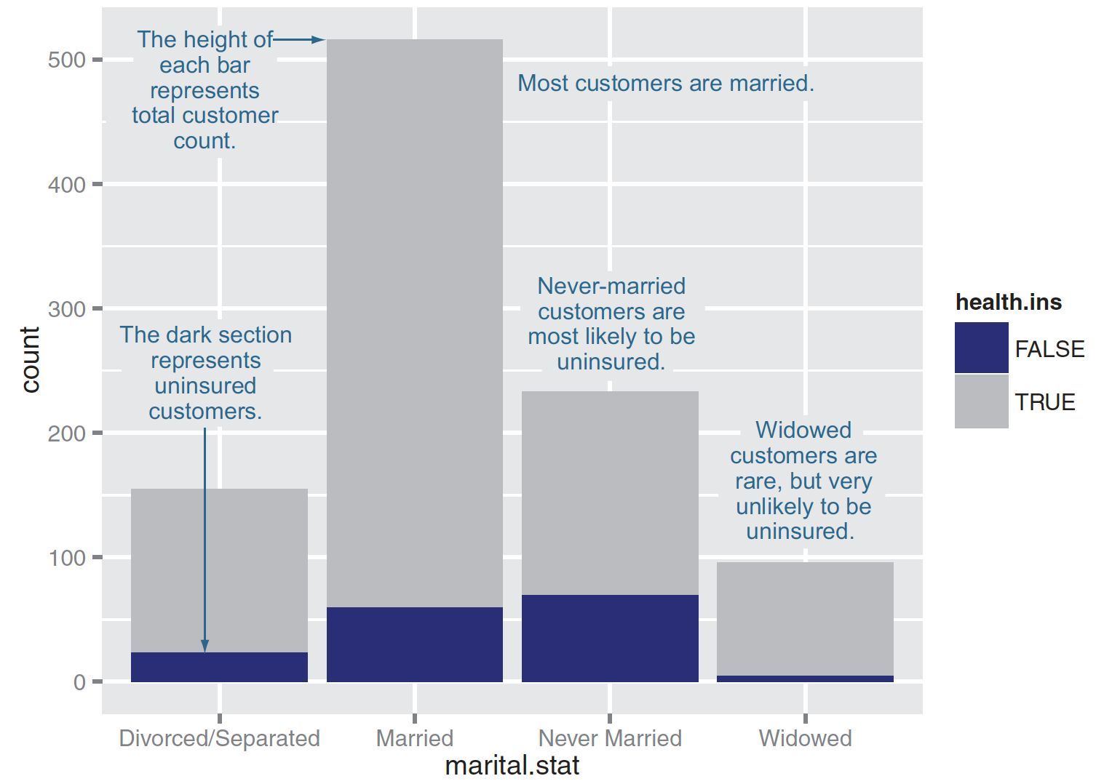
Stacked bar chart for two categorical variables
ggplot(custdata) + geom_bar(aes(x=marital.stat,
fill=health.ins))
Figure3.15, Practical Data Science with R by Nina Zumel, John Mount

Slide 54
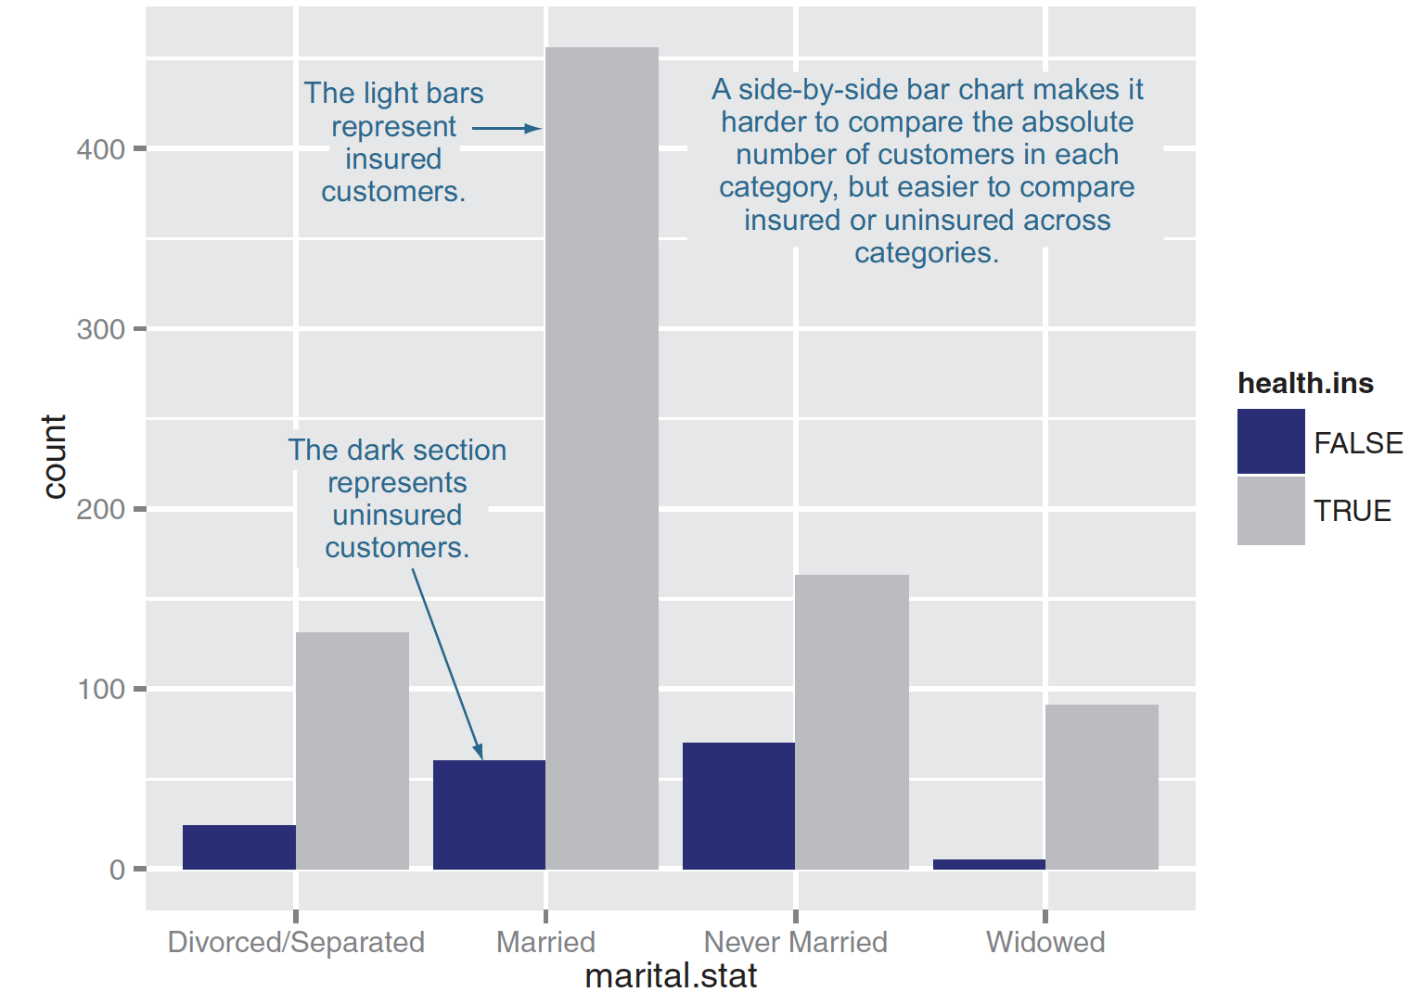
Side-by-side bar chart
ggplot(custdata) + geom_bar(aes(x=marital.stat,
fill=health.ins),
position="dodge")
Figure3.16, Practical Data Science with R by Nina Zumel, John Mount

Slide 55
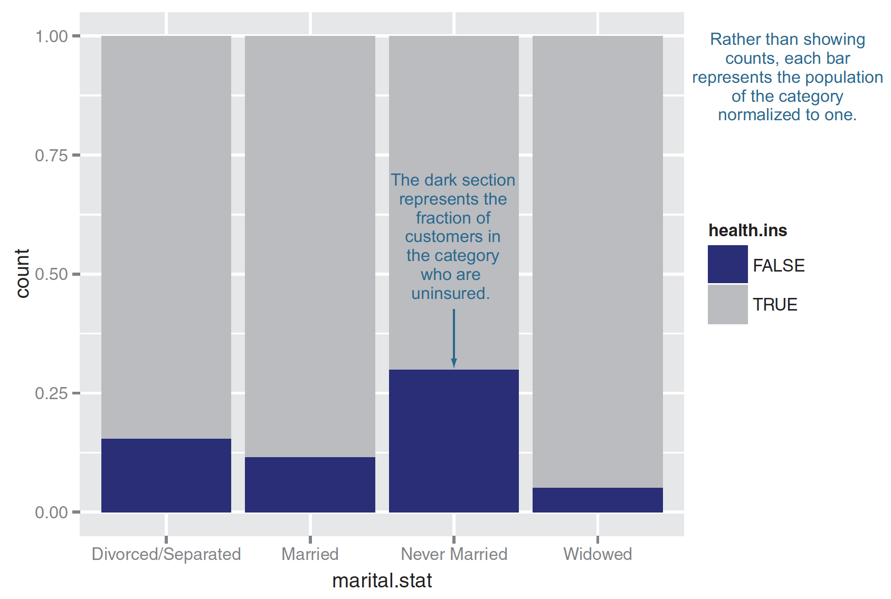
Filled bar chart
ggplot(custdata) + geom_bar(aes(x=marital.stat,
fill=health.ins),
position="fill")
Figure3.17, Practical Data Science with R by Nina Zumel, John Mount

Slide 56
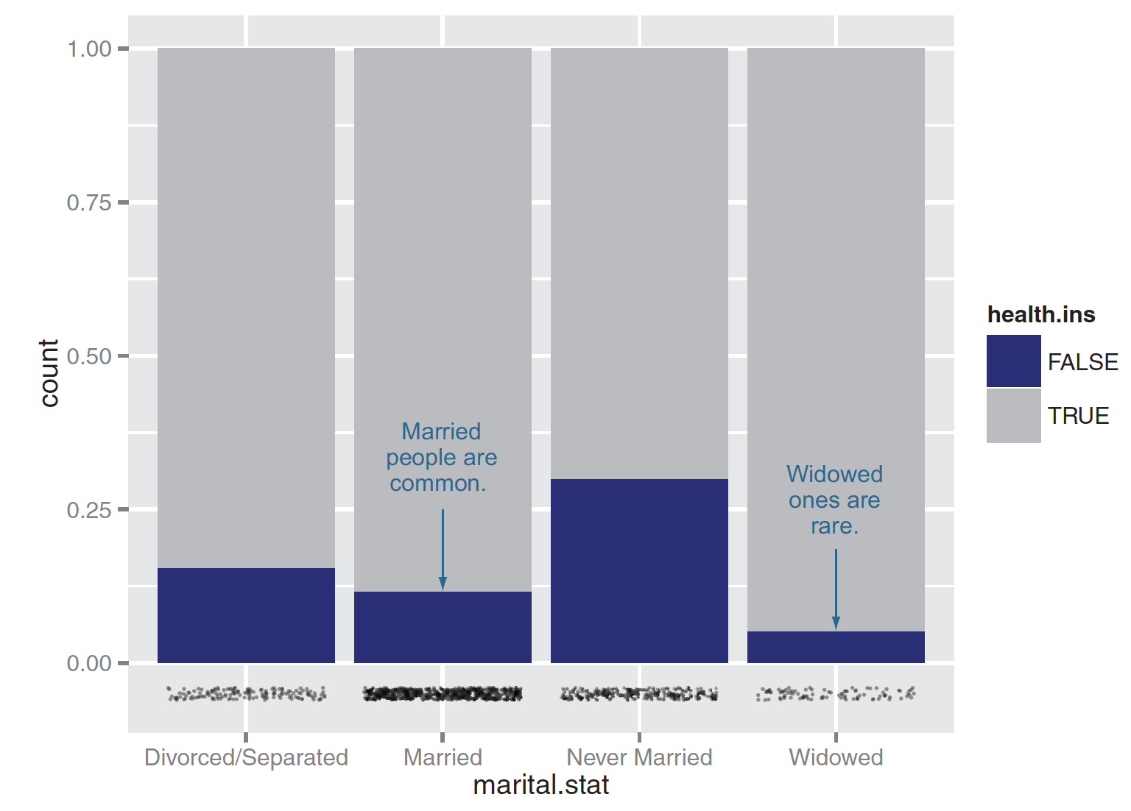
Plotting data with a rug
ggplot(custdata, aes(x=marital.stat)) +
geom_bar(aes(fill=health.ins), position="fill") +
geom_point(aes(y=-0.05), size=0.75, alpha=0.3,
position=position_jitter(h=0.01))
Figure3.17, Practical Data Science with R by Nina Zumel, John Mount

Slide 57
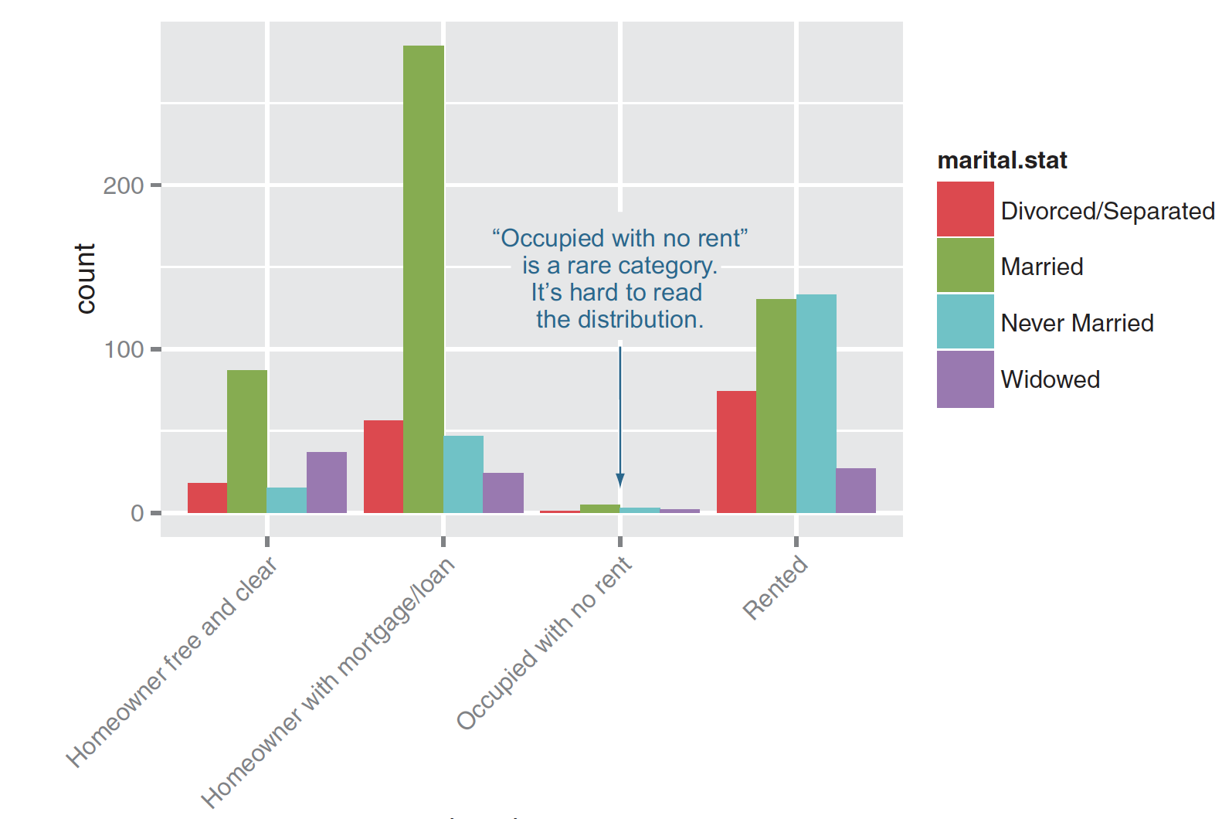
Plotting a bar chart without facets
ggplot(custdata2)+
geom_bar(aes(x=housing.type, fill=marital.stat ), position="dodge")+
theme(axis.text.x = element_text(angle = 45, hjust = 1))
Figure3.19, Practical Data Science with R by Nina Zumel, John Mount

Slide 58
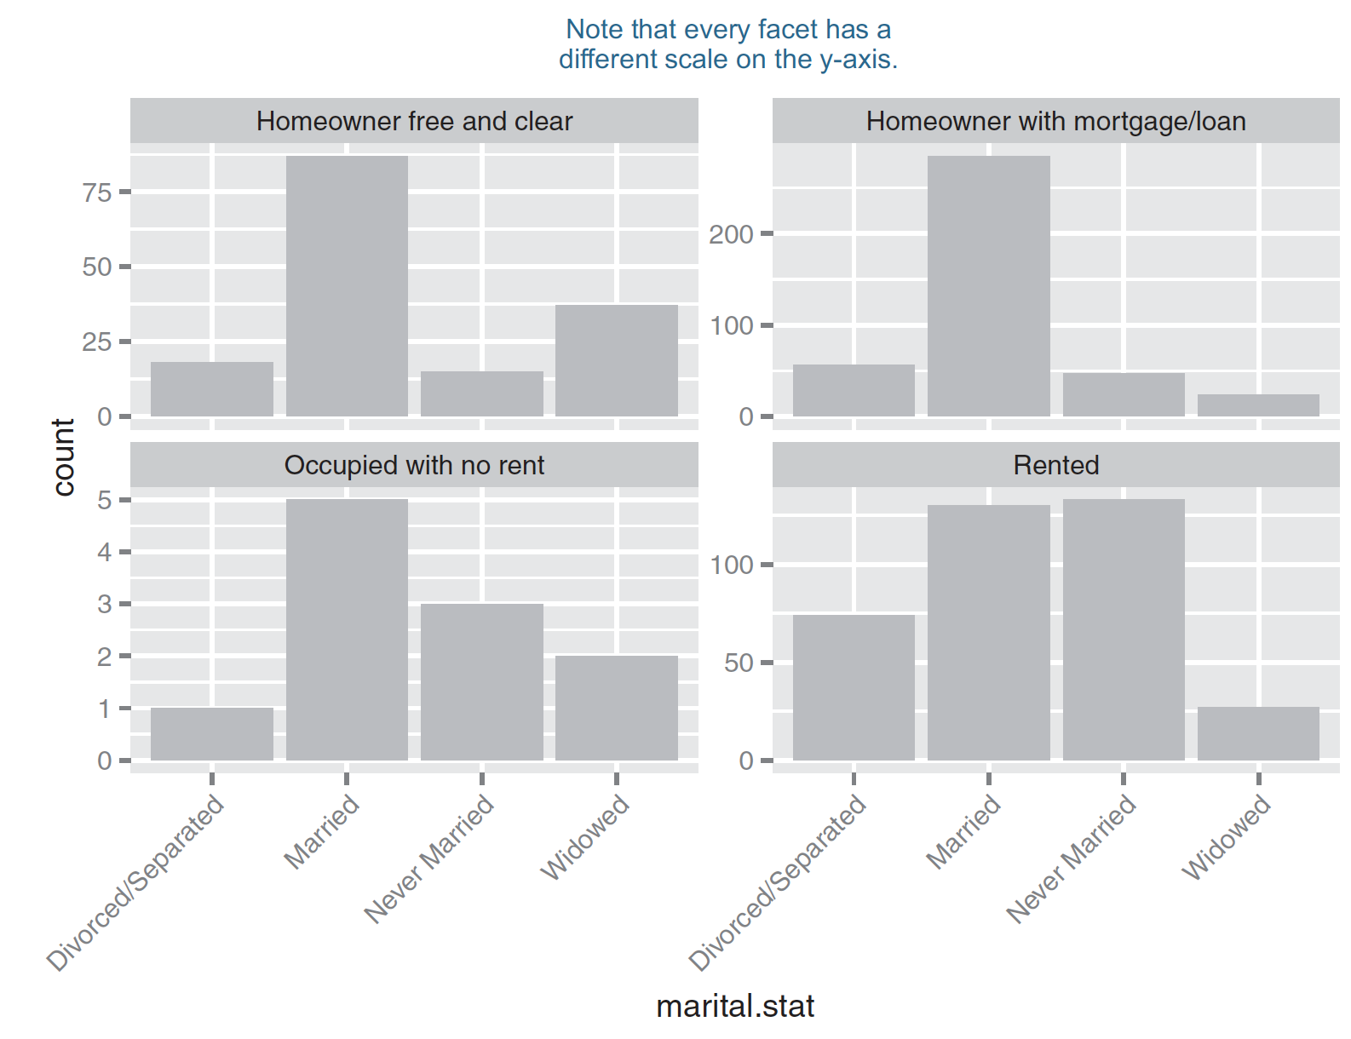
Plotting a bar chart with facets
ggplot(custdata2) + geom_bar(aes(x=marital.stat), position=“dodge”, fill=“darkgray”) + facet_wrap(~housing.type, scales="free_y") + theme(axis.text.x = element_text(angle = 45, hjust = 1))
Figure3.20, Practical Data Science with R by Nina Zumel, John Mount

Slide 59
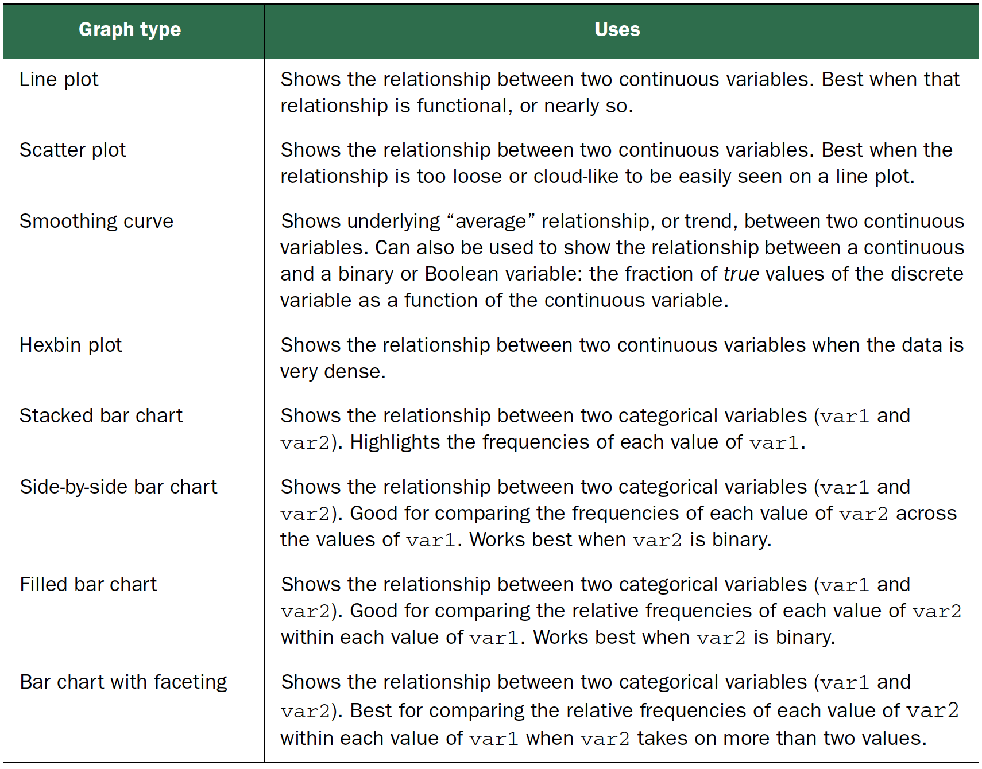
Visualizations for two variables
Practical Data Science with R by Nina Zumel, John Mount

Slide 60
Interactive visualization

Slide 61
ggvis
http://ggvis.rstudio.com/
interactive plots from the makers of ggplot2
a data visualization package for R which lets you:
Declaratively describe data graphics with a syntax similar in spirit to ggplot2.
Create rich interactive graphics that you can play with locally in Rstudio or in your browser.
Leverage shiny’s infrastructure to publish interactive graphics usable from any browser (either within your company or to the world).

Slide 62
ggvis
The goal is to combine
the best of R (e.g. every modelling function you can imagine)
the best of the web (everyone has a web browser).
Data manipulation and transformation are done in R, and the graphics are rendered in a web browser, using Vega.
For RStudio users, ggvis graphics display in a viewer panel, which is possible because RStudio is a web browser.

Slide 63
Install necessary packages & Load packages
ggvis.R
## Install necessary packages
install.packages("devtools")
library("devtools")
install.packages("ggvis")
# Load packages
library("ggvis")
library(ggplot2)
Credit by Juuso Parkkinen, http://ouzor.github.io/blog/2014/11/21/interactive-visualizations.html

Slide 64
Prepare data
# Define image sizes
img.width <- 450
img.height <- 300
# Use mtcars data data(mtcars)
mtcars$cyl <- factor(mtcars$cyl)
mtcars$am <- factor(mtcars$am)
# Compute mean mpg per cyl and am
mtcars.mean <- mtcars %>% group_by(cyl, am) %>% summarise(mpg_mean=mean(mpg)) %>% select(cyl, am, mpg_mean) %>% ungroup()
Credit by Juuso Parkkinen, http://ouzor.github.io/blog/2014/11/21/interactive-visualizations.html

Slide 65
Histograms
ggplot
hist.ggplot <- ggplot(mtcars, aes(x=mpg)) + geom_histogram(binwidth=1)
hist.ggplot
ggvis
hist.ggvis <- mtcars %>% ggvis(x = ~mpg) %>% layer_histograms(width=1) %>% set_options(width = img.width, height = img.height)
hist.ggvis
Credit by Juuso Parkkinen, http://ouzor.github.io/blog/2014/11/21/interactive-visualizations.html

Slide 66
Why %>%?
ggvis uses the pipe operator %>% (familiar for dplyr users), replacing the + in ggplot2
# convert engine displacment to litres
mtcars %>%
ggvis(x = ~mpg, y = ~disp) %>%
mutate(disp = disp / 61.0237) %>% layer_points()
mtcars %>%
ggvis(x = ~mpg, y = ~disp) %>%
layer_points()
Credit by http://ggvis.rstudio.com/ggvis-basics.html

Slide 67
Scatter plots
ggplot
scatter.ggplot <- ggplot(mtcars, aes(x=wt, y=mpg)) + geom_point()
scatter.ggplot
ggvis
scatter.ggvis <- mtcars %>% ggvis(x = ~wt, y = ~mpg) %>% layer_points() %>% set_options(width = img.width, height = img.height)
scatter.ggvis
mtcars %>% ggvis(~wt, ~mpg) %>% layer_points() %>% layer_model_predictions(model = "lm", se = TRUE)
Credit by Juuso Parkkinen, http://ouzor.github.io/blog/2014/11/21/interactive-visualizations.html

Slide 68
ggvis
p <- ggvis(mtcars, x = ~wt, y = ~mpg)
layer_points(p)
=>
layer_points(ggvis(mtcars, x = ~wt, y = ~mpg))
=>
mtcars %>% ggvis(x = ~wt, y = ~mpg) %>% layer_points()
Credit by http://ggvis.rstudio.com/ggvis-basics.html

Slide 69
Scatter plots by group
ggplot
scatter.ggplot <- ggplot(mtcars, aes(x=wt, y=mpg, colour=cyl)) + geom_point()
scatter.ggplot
Credit by Juuso Parkkinen, http://ouzor.github.io/blog/2014/11/21/interactive-visualizations.html

Slide 70
Scatter plots by group
ggvis
scatter.ggvis <- mtcars %>% ggvis(x = ~wt, y = ~mpg, fill = ~cyl) %>% layer_points() %>% set_options(width = img.width, height = img.height)
scatter.ggvis
mtcars %>%
ggvis(~wt, ~mpg, fill = ~factor(cyl)) %>%
layer_points() %>%
group_by(cyl) %>%
layer_model_predictions(model = "lm", se = TRUE)
Credit by Juuso Parkkinen, http://ouzor.github.io/blog/2014/11/21/interactive-visualizations.html

Slide 71
Line plots
ggplot
line.ggplot <- ggplot(mtcars.mean, aes(x=cyl, y=mpg_mean, colour=am)) + geom_line(aes(group=am))
line.ggplot
ggvis
line.ggvis <- mtcars.mean %>% ggvis(x = ~cyl, y = ~mpg_mean, stroke = ~am) %>% layer_lines() %>% set_options(width = img.width, height = img.height)
line.ggvis
Credit by Juuso Parkkinen, http://ouzor.github.io/blog/2014/11/21/interactive-visualizations.html

Slide 72
Layers
Simple, which include primitives like points, lines and rectangles.
mtcars %>% ggvis(~wt, ~mpg) %>% layer_points()
Compound, which combine data transformations with one or more simple layers.
mtcars %>% ggvis(~mpg) %>% layer_histograms()
Multiple layers
mtcars %>% ggvis(~wt, ~mpg) %>% layer_points() %>% layer_smooths()
Credit by http://ggvis.rstudio.com/ggvis-basics.html

Slide 73
Interaction: input_*
input_checkbox(): a check-box
input_checkboxgroup(): a group of check boxes
input_numeric(): a spin box
input_radiobuttons(): pick one from a set options
input_select(): create a drop-down text box
input_text(): arbitrary text input
Credit by hhttp://ggvis.rstudio.com/interactivity.html

Slide 74
density plot
plot(density(mtcars$wt))
The (S3) generic function density computes kernel density estimates. Its default method does so with the given kernel and bandwidth for univariate observations.
Kernel
bandwidth
Credit by hhttp://ggvis.rstudio.com/interactivity.html

Slide 75
Density plot with input_slider + check box
mtcars %>% ggvis(x = ~wt) %>%
layer_densities( adjust = input_slider(.1, 2, value = 1, step = .1, label = "Bandwidth adjustment"),
kernel = input_select( c("Gaussian" = "gaussian", "Epanechnikov" = "epanechnikov", "Rectangular" = "rectangular", "Triangular" = "triangular", "Biweight" = "biweight", "Cosine" = "cosine", "Optcosine" = "optcosine"), label = "Kernel") )
Credit by hhttp://ggvis.rstudio.com/interactivity.html

Slide 76
Interaction
mtcars %>% ggvis(~mpg, ~disp, size = ~vs) %>% layer_points()
mtcars %>% ggvis(~wt, ~mpg, size := 300, opacity := 0.4) %>% layer_points()
=>
mtcars %>% ggvis(~wt, ~mpg, size := input_slider(10, 100), opacity := input_slider(0, 1) ) %>% layer_points()
=>
slider <- input_slider(10, 1000)
mtcars %>% ggvis(~wt, ~mpg) %>% layer_points(fill := "red", opacity := 0.5, size := slider)
Credit by http://ggvis.rstudio.com/ggvis-basics.html

Slide 77

Shiny
an R package that makes it easy to build interactive web applications (apps) straight from R.
http://shiny.rstudio.com/
Credit by http://ggvis.rstudio.com/ggvis-basics.html

Slide 78
Shiny
helloShiny.R
install.packages("shiny")
library(shiny)
runExample("01_hello")
Shiny apps have two components:
a user-interface script
a server script
Credit by http://ggvis.rstudio.com/ggvis-basics.html

Slide 79
Running an App
runApp1.R
Hello World
Change the title from “Hello Shiny!” to “Hello World!”.
Set the minimum value of the slider bar to 5.
Change the histogram color from "darkgray" to "skyblue".
Relaunching Apps
Credit by http://ggvis.rstudio.com/ggvis-basics.html

Slide 80
hello, world!
While small test programs have existed since the development of programmable computers, the tradition of using the phrase "Hello, world!" as a test message was influenced by an example program in the seminal book The C Programming Language. The example program from that book prints "hello, world" (without capital letters or exclamation mark), and was inherited from a 1974 Bell Laboratories internal memorandum by Brian Kernighan, Programming in C.A Tutorial.
Credit by https://en.wikipedia.org/wiki/%22Hello,_World!%22_program

Slide 81
The C Programming Language
sometimes termed K&R
computer programming book written by Brian Kernighan and Dennis Ritchie, the latter of whom originally designed and implemented the language.
The book was central to the development and popularization of the C programming language and is still widely read and used today.

Slide 82
Shiny examples
system.file("examples", package="shiny")
runExample("01_hello") # a histogram
runExample("02_text") # tables and data frames
runExample("03_reactivity") # a reactive expression
runExample("04_mpg") # global variables
runExample("05_sliders") # slider bars
runExample("06_tabsets") # tabbed panels
runExample("07_widgets") # help text and submit buttons
runExample("08_html") # Shiny app built from HTML
runExample("09_upload") # file upload wizard
runExample("10_download") # file download wizard
runExample("11_timer") # an automated timer
Credit by http://shiny.rstudio.com/tutorial/lesson1/

Slide 83
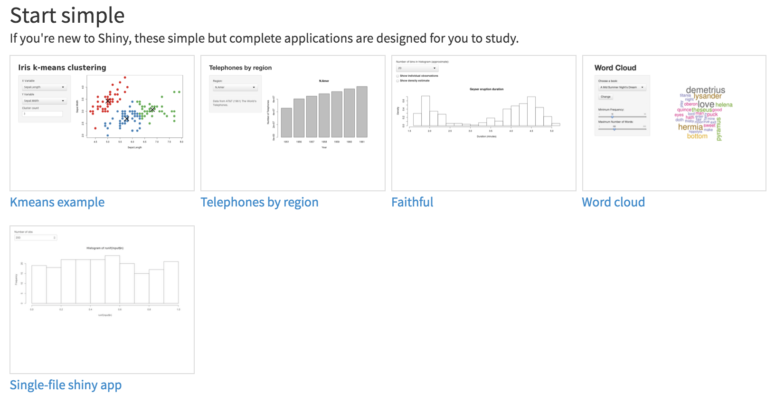
Shiny Gallery
http://shiny.rstudio.com/gallery

Slide 84
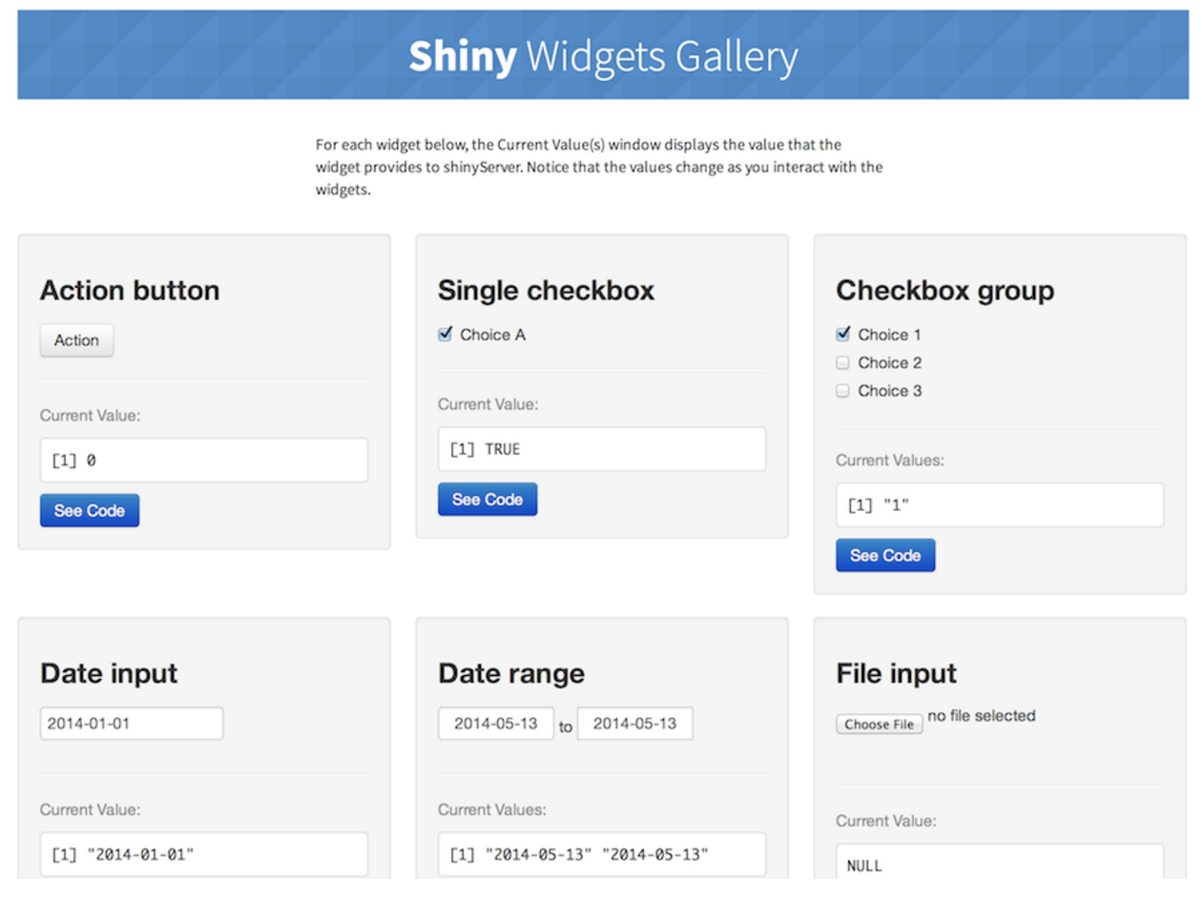
Shiny Widgets Gallery
http://shiny.rstudio.com/gallery/widget-gallery.html

Slide 85
Share your apps
Share your Shiny app as one file with two function
server
ui
Share your Shiny app as a web page.
Credit by http://shiny.rstudio.com/tutorial/

Slide 86
Share your Shiny app as two files
runUrl
runUrl(’url’)
runUrl('https://github.com/rstudio/shiny_example/archive/master.tar.gz')
runGitHub
runGitHub( "<your repository name>", "<your user name>")
runGitHub("shiny_example", "rstudio")
runGist
runGist("3239667")
Credit by http://shiny.rstudio.com/tutorial/

Slide 87

Share as a web page
Shinyapps.io

Slide 88

Share as a web page

Slide 89
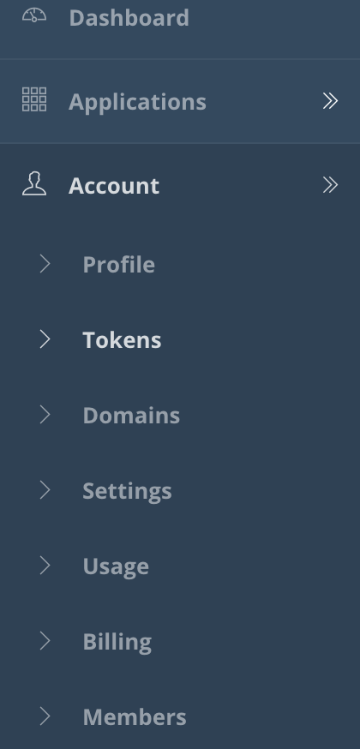
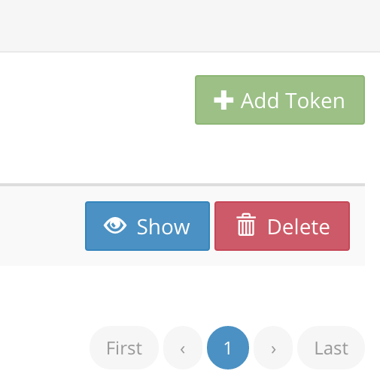

Registration

Slide 90
Share by Shinyapps.io
STEP 1 – INSTALL RSCONNECT
install.packages('rsconnect')
STEP 2 – AUTHORIZE ACCOUNT
rsconnect::setAccountInfo(name=‘jmchang', token=’***', secret=’***')
STEP 3 – DEPLOY
library(rsconnect)
rsconnect::deployApp('path/to/your/app')

Slide 91
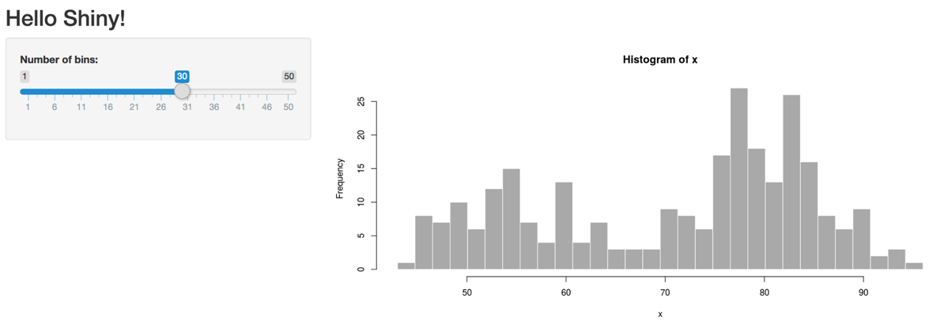
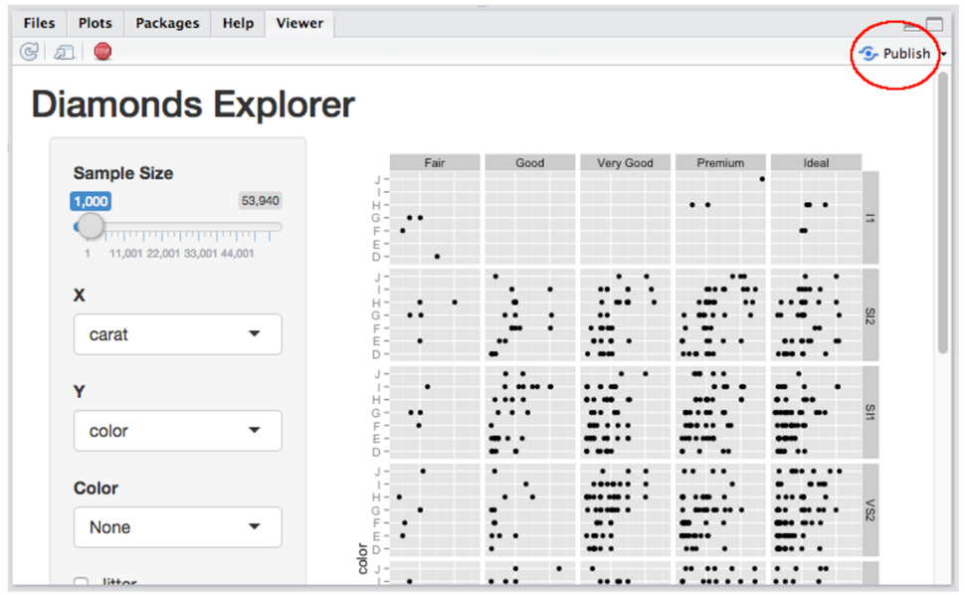
Share by Shinyapps.io
https://changlab.shinyapps.io/app1/

Slide 92
ggvis + shiny
https://changlab.shinyapps.io/ggvisExample/
server.r
library(shiny)
library(ggvis)
shinyServer(function(input, output, session) {
mtc <- reactive({ mtcars[1:input$n, ] })
mtc %>%
ggvis(~wt, ~mpg) %>%
layer_points() %>%
bind_shiny("plot", "plot_ui")
output$mtc_table <- renderTable({
mtc()[, c("wt", "mpg")]
})
})

Slide 93
ggvis + shiny
ui.r
library(ggvis)
shinyUI(pageWithSidebar(
div(),
sidebarPanel(
sliderInput("n", "Number of points", min = 1, max = nrow(mtcars),
value = 10, step = 1),
uiOutput("plot_ui")
),
mainPanel(
ggvisOutput("plot"),
tableOutput("mtc_table")
)
))

Slide 94
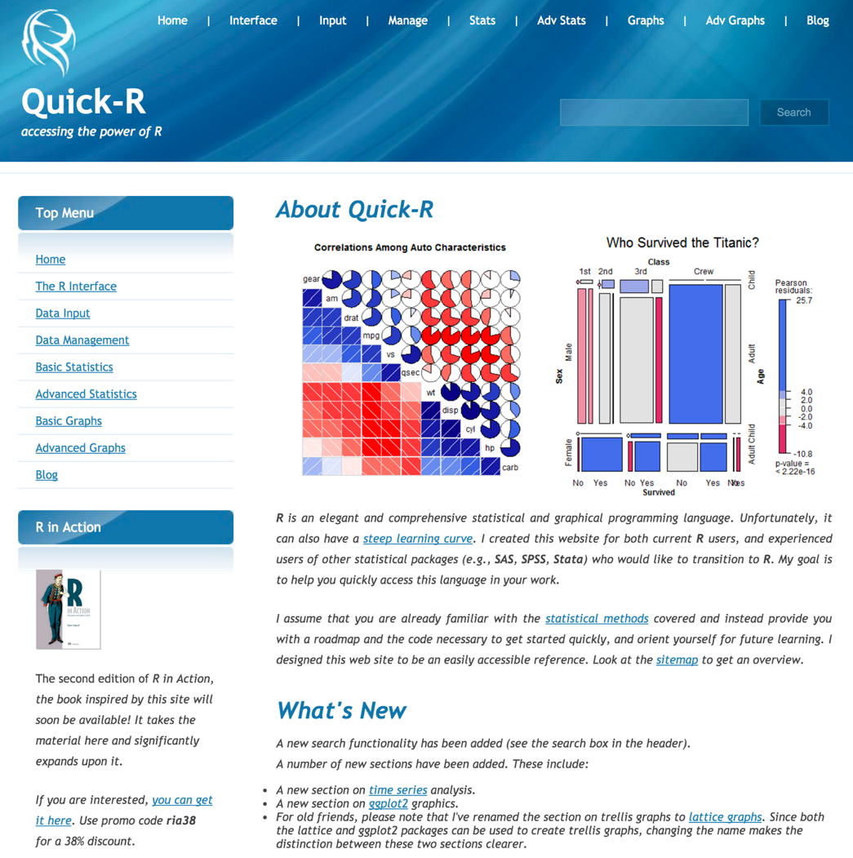
Quick-R
http://www.statmethods.net/

Slide 95
Reference
Visualizations 101 by Logi ANALYTICS
https://www.logianalytics.com/wp-content/uploads/2015/12/Visualizations-101.pdf

Slide 96
Reference
ggplot2 book: https://amzn.com/331924275X
R Graphics Cookbook by Winston Chang
Online http://www.cookbook-r.com/Graphs/
Graphical Data Analysis with R, by Antony Unwin
R for Data Science by Garrett Grolemund, Hadley Wickham

Slide 97
2017 台灣資料科學年會
Big Data Visualization 馬匡六, University of California at Davis Professor
重新認識資料視覺化 王昱舜, 交通大學資訊工程系副教授

Slide 98


Thank You Any Question?

